Slide 1
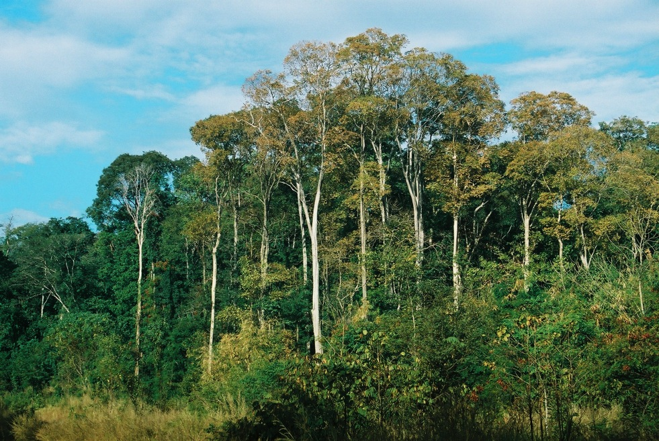
Primary assessment on drivers of deforestation and forest degradation in Cambodia
Chhun Delux
Forest Administration, Cambodia
E-mail: chhundelux83@gmail.com
Photo Credit: WCS(2009)

Slide 2

Presentation Structure
I. Overview of trends in forest and land use
II. Drivers of deforestation and degradation
Conversion forest to large scale agro-cropping and mining
Conversion forest to settlement and farmland
Conversion of forest to large scale infrastructure development
Drivers of Forest Degradation
III. Policies and measures (PAMs) addressing
deforestation and forest degradation in Cambodia
IV. Analysis

Slide 3

Trend in forest and land use in Cambodia

Slide 4
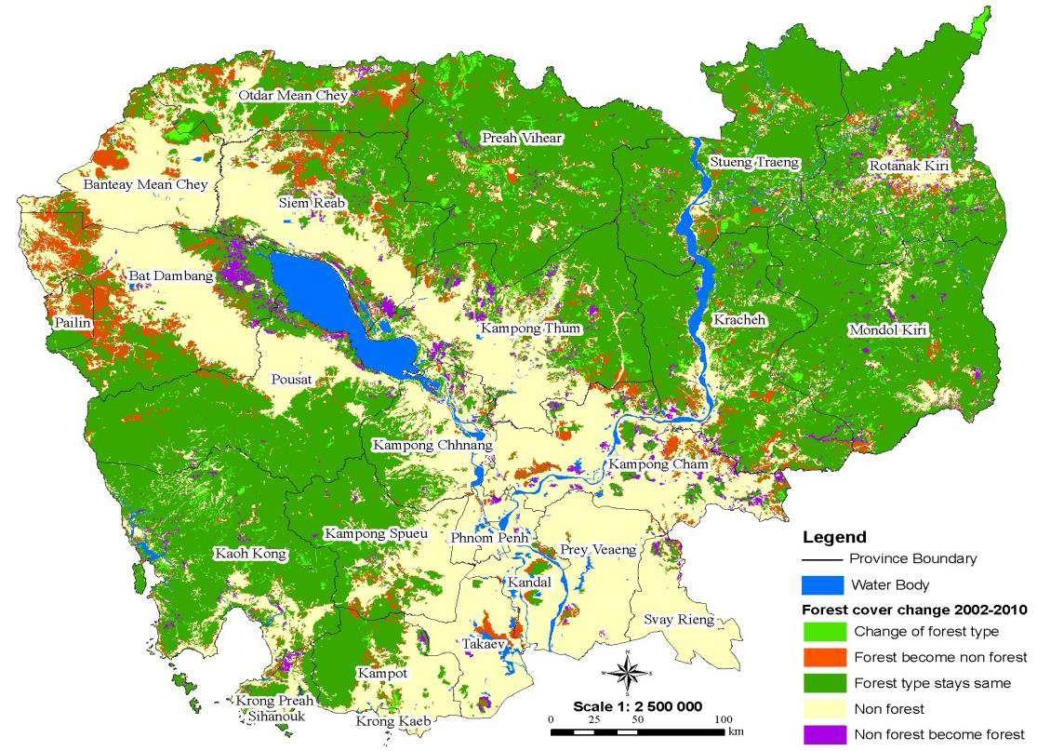
Forest Cover Change map 2010 (Source: FA 2011).

Slide 5
Historical Drivers of Deforestation and Forest Degradation in Cambodia
Before the 1970s, Cambodia’s forest area remained relatively constant
Since the 1970s, forest area began to decline due to effects of the Vietnam War and suffer from unstable political situations.
Starting in the 1990s, as a result of rapid economic growth and fragile environmental regulations, 60% of the country was leased to private timber industry, which led to widespread deforestation and forest degradation
Land speculation driven by high prices lead to forest clearing in recent years.
economic land concessions
Forest degradation is also caused by unsustainable fuel wood collection and charcoal production and un-control logging.

Slide 6
II. Drivers of deforestation and degradation
A. Conversion forest to large scale agro-cropping and mining
Economic Land Concession ( Less than 1000 Ha)
ELC have been granted in Cambodia since the 1990.
The MoE grants ELC licenses to private companies (both local and foreign) within sustainable use zones , Protected Area Law (2008) and Sub-decree 146 ANK/BK
MAFF grants ELCs in accordance to the Sub-decree 146 ANK/BK
Inter-ministries committees set up to enforce Sub-decree 146 ANK/BK

Slide 7
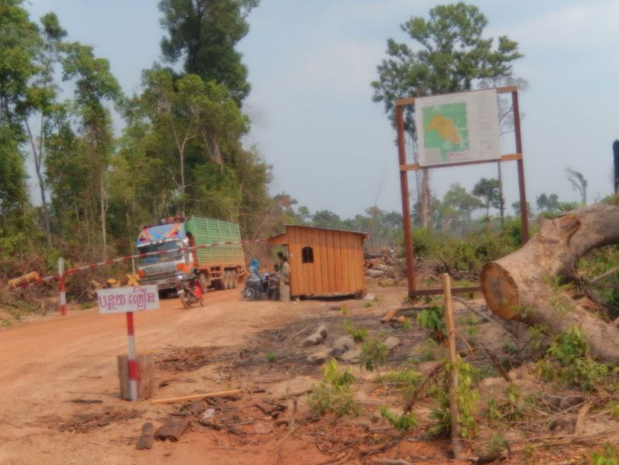
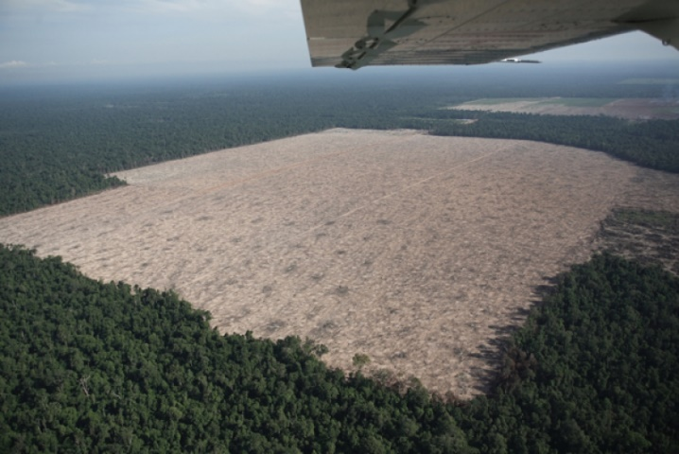
Economic Land Concession
 | No. ELCs | Ha | Data sources & date
ODC | 301 (whole country) | 2.11 million | ODC (2015)
MAFF | 118 | 1.20 Million | MAFF (08 June 2012)
MoE | 87 | 482,543 ha | GIS-MoE, (2014)
UNEP & WCMC | 160 (whole country) | 1.7 million | UNEP (2010)

Slide 8
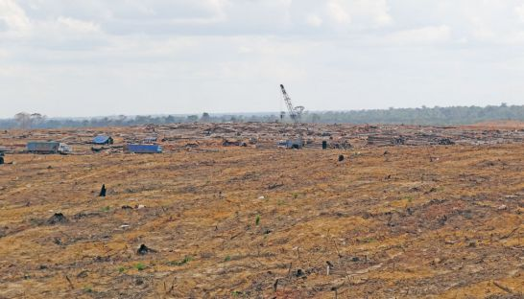
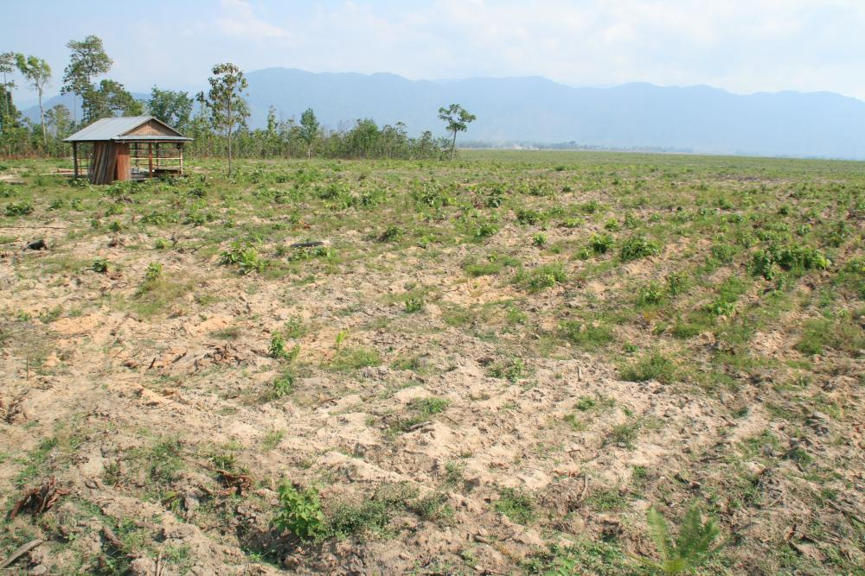
Small Scale economic land concession (ELC less than 1000 ha)
The provincial-level authorities previously had the power to grant concessions for less than 1000 hectares,
After enforcement of sub-degree on ELC on 27 December, 2005, the 47 companies individually less than 1,000 ha have been granted by provincial authorities in 9 provinces, however but this authority was cancelled in 2008.

Slide 9
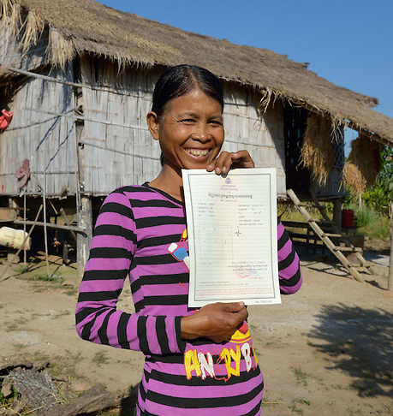
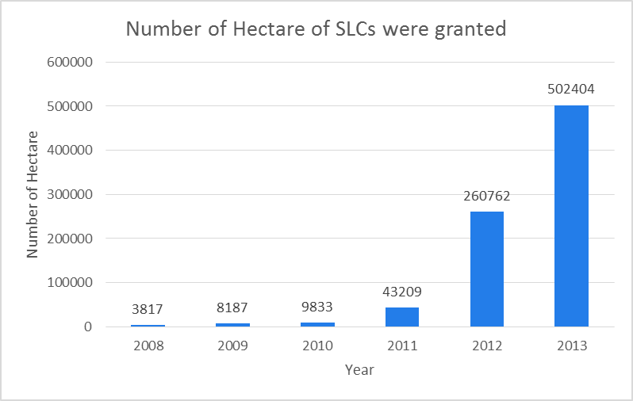
B. Conversion forest to settlement and farmland
Social Land Concession
SLC are a mechanism to grant state private land to poor landless families for SLC for residential use and/or family farming.
Regulated by the Sub-Decree on Social Land Concessions.
(1) Local Social Land Concession Programs,
(2) National Social Land Concession Programs,
(MLMUPC -Jan,2014).

Slide 10
Government Directive 001
In May 2012 Prime Minister Hun Sen issued Directive 001 (also known as Order 01BB) on “Measures to strengthen and enhance the effectiveness of management of economic land concessions (ELCs)”
Directive 001 also announced a moratorium on the granting of new ELCs, the review of existing ones and the implementation of the so-called “leopard-skin” (or “tiger-skin”) policy, aiming to allow communities to live side by side with the concessions.
Since the implementation of Directive 001 have been took into force and up to Jan 2014, 969 444.52 hectares were officially granted to land less families and forest public infrastructure development.
Source: (MLMUPC -Jan,2014).

Slide 11
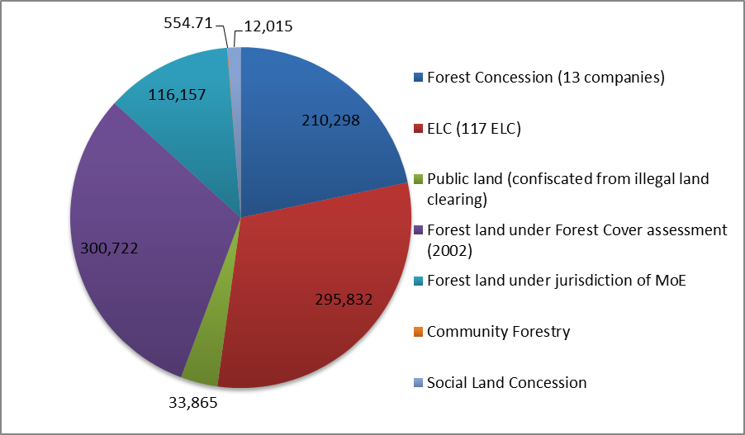
Forest land cut under Directive 001
Source: MLMUPC (2014)

Slide 12
Government Directive 001
Type of forest land deduced | Number of area deduced (hectare)
Forest Concession ( 13 companies ) | 210,297.70
ELC (117 ELC) | 295,831.75
Public land ( through confiscated from illegal land clearing) | 33,865.38
Forest land under Forest Cover assessment (2002) | 300,722.41
Forest land under jurisdictional of MoE | 116,157.09
Community Forestry | 554.71
Social Land Concession | 12,015.48
Total | 969 444.52
(MLMUPC -Jan,2014)

Slide 13
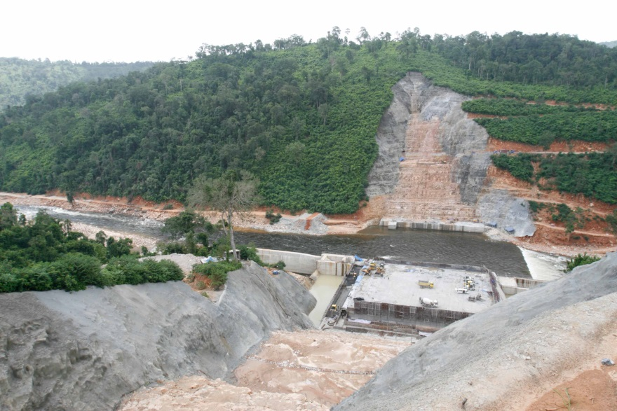
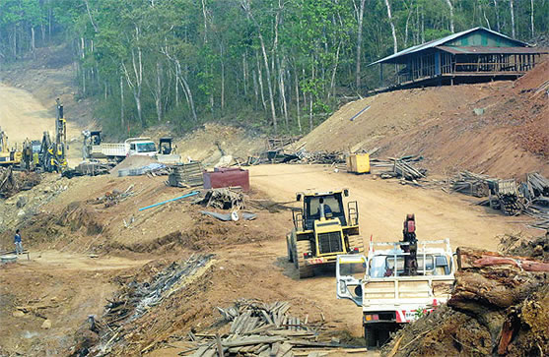
C. Conversion of forest to large scale infrastructure development
Electricity Dam Construction
Cambodia has several hydropower projects under development that induce the forest loss in the reservoir
Data in 2013 show that 11 electricity dams were constructed covers 305 250 hectares of forest land (FA, 2012).
The status of forest land clearing activities in each of the dam projects is unavailable; therefore, there is a need to identify deforestation area induced by dam construction.

Slide 14
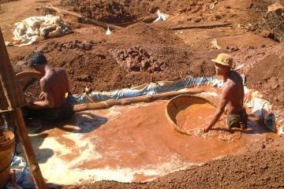
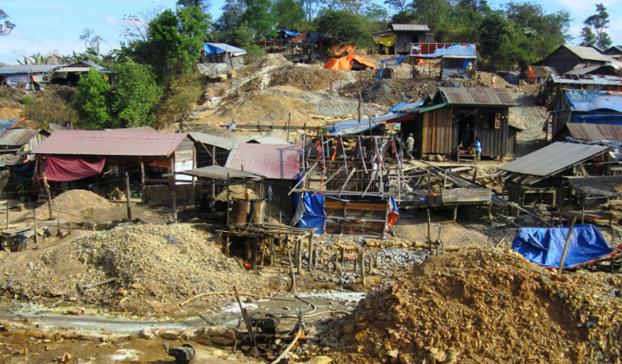
Mining concession
According to ODC data 2013, there are a number of mining areas in Cambodia that total more than 401 882 hectares in concession area.
The FA does not have data on mining areas, as the activity is not under their jurisdiction but theFA does regulate logging activities where the company must develop a log list for trees harvested through mining operations.
FA is responsible for measuring logs extracted, hammer marking logs and issuing a Licence Permit and PC according to procedures. Actual mining operations within the concession areas may be based on exploration and impact of a very small area.

Slide 15
Road Construction
The improvements in accessibility to remote forested areas encouraged initially by a rapid increase in commercial logging activity in the 1990s, which ceased with the Government declared logging moratorium in 2002,
The new road construction itself strongly correlates with deforestation and induced illegal small-scale forestland or encroachment settlements that emerge alongside the road.
Evidence shows the main roads were constructed from Snoul district to Mundulkiri; this re-construction caused massive small-scale deforestation and increasing illegal logging in Snoul wildlife sanctuary.
The main road from Kraite to Stung Treng, and Kompong Thom provincial town to Preah Vihear.

Slide 16
Illegal forestland conversion/illegal forestland speculation at household scale
According to FA data, illegal small-scale forestland clearing has decreased from 11,179 ha in 2010 to 251 ha in 2014, while illegal forestland clearing inside PA remains unrecorded under the GDANCP system.
Forestland confiscated by Forestry Administration, 2010-2014 (Ha)
Type of forestland | 2010 | 2011 | 2012 | 2013 | 2014
Small-scale Illegal forestland clearing(in Forestry Administration recording system) | 11,179 | NA | 111,837 | 1,721 | 251
Small-scale illegal forestland clearing (confiscated and convert to state owned property) | 19,382 | NA | 15,827 | 1,864 | 811

Slide 17
Forest Concession and local coup/annul coup
Cambodia established a logging concession system during 1994-1997 whereby the Government granted 36 Forest Concessions covering nearly 7 million hectares, (close to 70% of the forest area) (FA,2009)
Currently apro- 3.3 million hectares of forest still under valid concession licenses (FA, 2010).
The future of Forest Concessions is not clear for companies holding valid (not expired) concession licenses .
The FA and MAFF manages the allocation of forest areas for annual forest coupe for bidding that is open to private companies. The Government only had one coupe permit for 2012 within Production Forests in Cambodia thus forming an insignificant portion of the current timber supply.
Province | Permit area | Area (hectares) | Inventory volume (m3) | Harvest volume (m3)
Mondul Kiri | Coupe 4 | 1 342 | 6 086.6 | 4 456.5

Slide 18
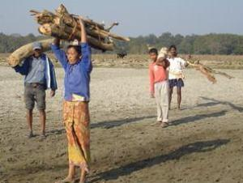
Fuel wood harvesting
The main energy source in Cambodia is wood, accounting for 80% of national energy consumption (UNEP, 2010).
Most households, even in urban areas, rely on traditional energy sources since fossil fuels are either not available or too expensive. 94% of the population living in rural areas relies on wood, charcoal, car batteries and kerosene (UNCDF, 2010).
Most primitive fuels are sourced from forests; in rural areas in the form of fuel wood and in towns and cities as charcoal (UNCDF, 2010).
The UNDP forecasts that wood-derived fuels will​ remain the main source of cooking energy in rural areas until 2030 (UNDP, 2008).
However, the amount of fuel wood collected from the forest unavailable and type of wood fuel wood remaining not identified.

Slide 19
Regional and global demand for wood/timber
Timber export: Export data from 2003–2012 was obtained through the published statistics of Forestry Statistics Cambodia (RGC 2012). The data published by the Government in Forestry Statistics Cambodia in 2012 differs significantly from FAO reported data on total volumes of timber exported annually from 2003–2011.
According to FA, 85% of the total volume of timber exported in 2011 went to China with only 13% to Vietnam.
80% of exported timber were from cleared of Forest land under ELCs
Year | FAO (Data) | FA (Data)
2010 | 39 013 m³ | 15 907 m³
2011 | 17 751 m³ | 29 811 m³
2012 | ? | 317 897 m³
2013 | ? | 39 742 m³
2014 | ? | 75 291 m³
Sources: (FAO,2010 &Department of Forest Industrial and International Cooperation/FA 2014)

Slide 20
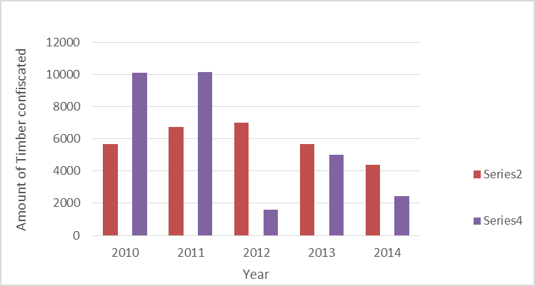
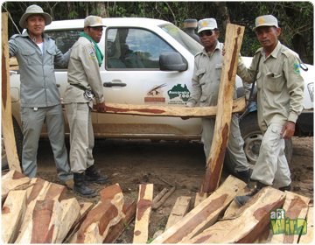
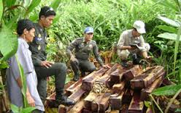
Illegal logging
FA
MoE
Sources: (FAO,2010 &Department of Forest Industrial and International Cooperation/FA 2014)

Slide 21
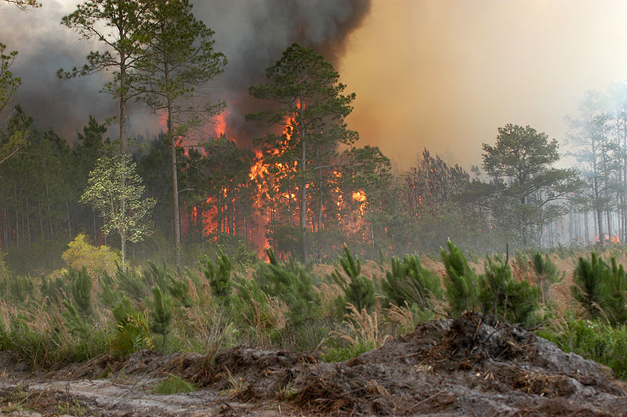
Forest Fire
Generally agreed that very frequent burning degrades forest
but more research needed

Slide 22
In direct and underlying cause and scale of deforestation and forest degradation
Electricity Consumption
Approximately 22% of Cambodians have access to electricity, though Phnom Penh (around 10% of the population), uses more than 85% of total electricity consumed (UNCDF, 2010).
In 2010 electricity imports from Thailand and Vietnam made up over 40% of the country’s total supply.
The Electricity Authority of Cambodia (EAC) reported total electricity consumption in 2008 as 1859 GWh, with expected annual growth of 12% per year until 2024 and 5% per year until 2050.
MIME plans electricity generation and expects that by 2020 68% will be generated by hydro dams and 15% by coal fired power plants.

Slide 23
Direct and underlying cause and scale of deforestation and forest degradation
Lack of financial support in forestry sector
Annual report of MAFF (2013-2014) presented that the RGC collected 15.83 million USD (4000 riels=1 USD) from forestry sector but only small amount of budget will return to support forestry sector.
Data from TWG-FR presented in 2014 indicated that 21.58 million were invested in the implementation of NFP, and however 98.64% invested by donors and NGOs partners, and 1.36% invested by the government (TWG-FR, 2014).
NFP-Prorgamme | Year(2014)
P1: Forest Demarcation | 0.51
P2: Conservation | 59.97
P3: FLEG | 5.60
P4: Community Forestry | 15.08
P5: Capacity Building | 6.06
P6: Forest Financing | 13.74
Total | 100%

Slide 24
Underlying cause and scale of deforestation and forest degradation
Weak in forest governance
Weak of Land Tenure
Rural Poverty
Population growth and in- migration
Lack of long term financial to support forest sector

Slide 25
Actors influence drivers of deforestation and forest degradation
a. Relevance government institution
Ministry of Agriculture Forestry and Fishery (MAFF)
Ministry of Environment (MoE)
Ministry of Commerce (MoC)
Ministry of Land Management Urban Planning and Construction
Ministry of Mining and Energy
b. Civil Society Organization
c. Local community and Indigenous community
d. Private Sector
e. International Donor
f. Regional Government country partners

Slide 26
III. Policy and measure to address deforestation and forest degradation
Cambodian Government agencies (FA/MAFF, GDANCP/MoE, FiA/MAFF) already have a long experience of implementing projects to reduce deforestation and protect existing forests in areas under their jurisdiction.
The Government has developed a National Forest Programme 2010–2029 whereby the 10.8 million hectares of forest areas are classified into five land use categories.
Targeted under NFP (2010-2029)
Area | Size | Regulated by
Protected Areas | 3 million ha | MoE
Protected Forests | 3 million ha | MAFF
Community Forests | 2 million ha | MAFF
Forests Under Private Concessions | 0.3 million ha | MAFF
Production Forests | 2.6 million ha | MAFF

Slide 27
National Forest Program/Forestry Law (2002)
Protection Forest
Community Forestry Program
Protected Area Law (2008)
National PA strategic Framework
National PA strategic management plan
Land Law (2000)
Forest Lane Enforcement Governance and Trade
Anti-corruption Law
Draft- ESIA Law
Draft- National REDD+ strategy
Other government relevance policy
Order 01BB on Measures for Strengthening and Increasing the Effectiveness of the Management of Economic Land Concessions

Slide 28
IV. Analysis
In general, there were significant inconsistencies in availability of data and records in respect to land use and associated management of forest areas in Cambodia.
Production Forest areas that total 1.2 million hectares are not identified within each province or on the current land use map (GFS, 2014)
The RGC identified 10.8 mil classified as forests based on forest cover that was divided into five functional land use categories: Protected Area, Protected Forests, Community Forests, Forest Concessions and Production Forests in accordance with the NFP.
However, Population growth , demand for fuel wood and timber, and demand for land might effect to the 10.8 million forest conservation
(i.e increase No. of SLC, Increase export timber, increase population, and increase dam construction..)

Slide 29
The MoE regulates PA based on defined zones for protection in core and conservation zones and land use within sustainable use and community zones.
However, zoning of Protected Areas has not been completed to define sustainable use zones and community zones- risk at land conversion to other land use ( i.e ELC or SLC in Protected Are)
Timber originating from ELCs contributes more than 80% of the timber supply to the domestic and export markets that are regulated by the MoE and MAFF for other forest areas.
If the demand remaining high it is possible to expand ELC ( in any cases or need to create alternative sources of timber in the future )
Forest Concessions occupy approximately 3.3 million hectares that are still under a harvesting moratorium, the future of the these concession remaining not clear.

Slide 30
Population is an important factor with respect to its effect on the changes in forest area in Cambodia – lead to the extension of agriculture land area
Data on ELC establishment from the MoE and MAFF is not easily available with respect to area and locations.
Unclear planning in forestland allocation inside the PA and classification of Production Forests induce deforestation and degradation.
. The CFs are targeted to grow to 2 million hectares from the current 329,587 hectares (2015) of approved CF areas. CF needs assistance from FA to ensure forests are managed to produce a sustainable yield.
The significant increasing numbers of SLCs in the past four years, if the trend continues to rise, is likely to result in more forestland being converted.

Slide 31
Thank you !

