Slide 1

Impact Assessment of Woodfuels Consumption on Deforestation and Forest Degradation in Cambodia
Himawari Hotel, 3 September 2015

Slide 2
Outline
Understanding key terms and data
Introduction: Importance of woodfuels
Study Objectives
National woodfuels demand
Impact of woodfuels
Discussion
Simulation of strategic planning

Slide 3
Some definitions
Woodfuels = firewood/fuelwood + charcoal
1 kg of charcoal requires 6.4 kg wood
1 kg of charcoal has 3 times the amount of energy of 1 kg firewood
Above ground biomass (AGB) is living biomass, total quantity or weight of plant organisms derived from trees in a given area, above the soil, generally refers to the trees, including branches, twigs, foliage, and stump.
Mean Annual Increment (MAI) is the average annual growth of the AGB.

Slide 4
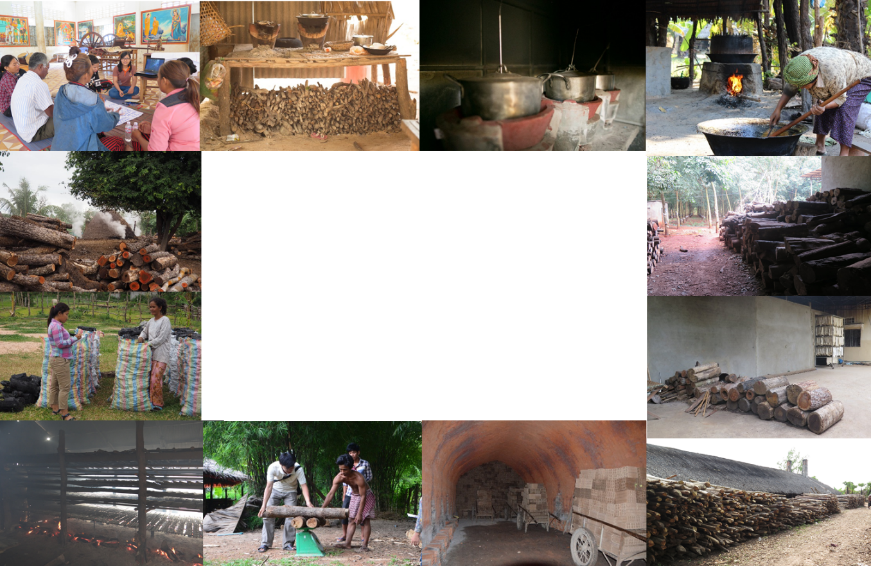
Results of 3 years of researches from GERES

Slide 5
The importance of woodfuels in the energy mix

Slide 6
Woodfuels remain important regardless of wealth
GERES survey from 1,969 households, representative of the Cambodian population, shows that the share of households that use charcoal as a primary fuel does not decrease with an increase in wealth.

Slide 7
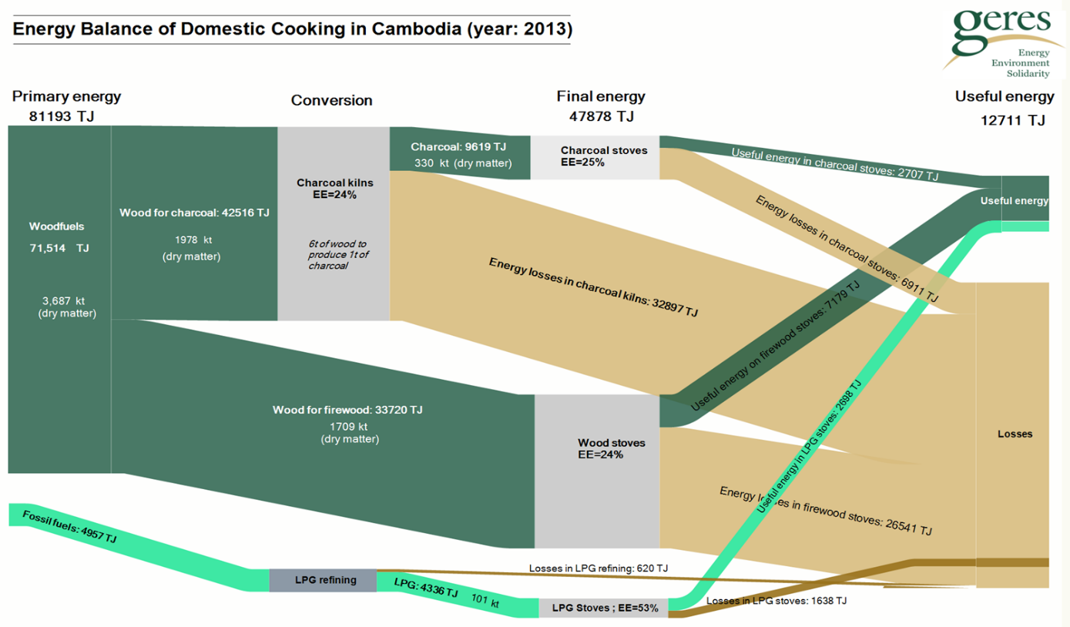
Currently woodfuels use is highly inefficient

Slide 8
Study Objectives

Slide 9
Study objectives
To determine the share of woodfuels which is sourced from forest and non-forest land in Cambodia; and
To assess the impact of woodfuels consumption on deforestation and forest degradation.

Slide 10
National demand of woodfuels

Slide 11
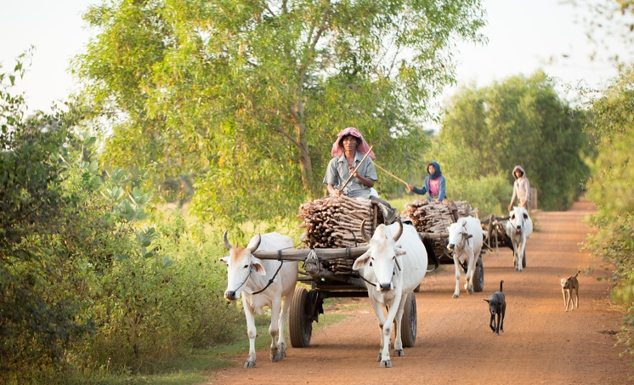
Annual woodfuels demand in Cambodia
1,300,000 tonnes of firewood collected locally for cooking

Slide 12
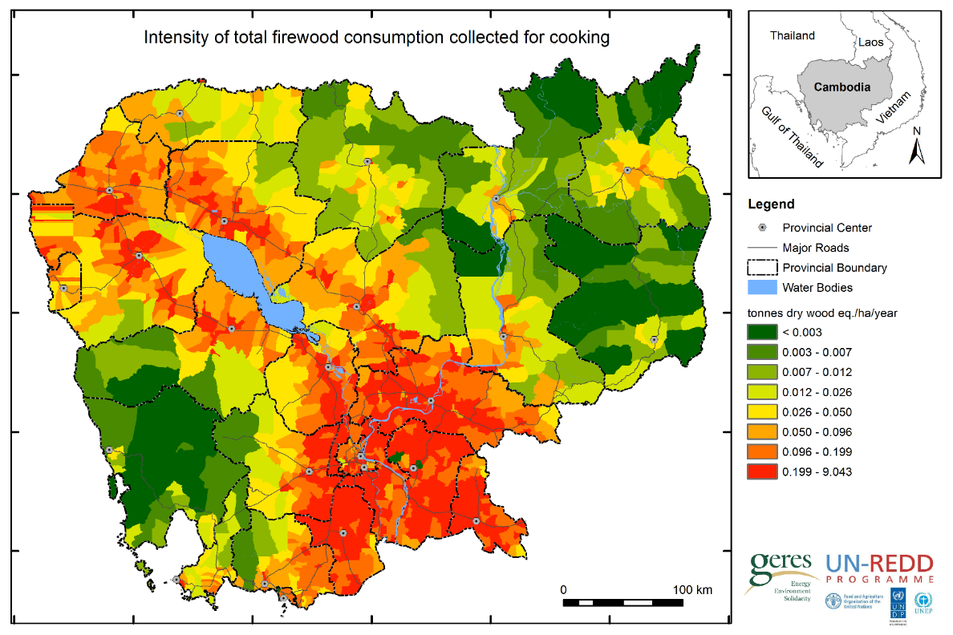
Annual woodfuels demand in Cambodia

Slide 13

Annual woodfuels demand in Cambodia
440,000 tonnes of firewood bought for cooking

Slide 14
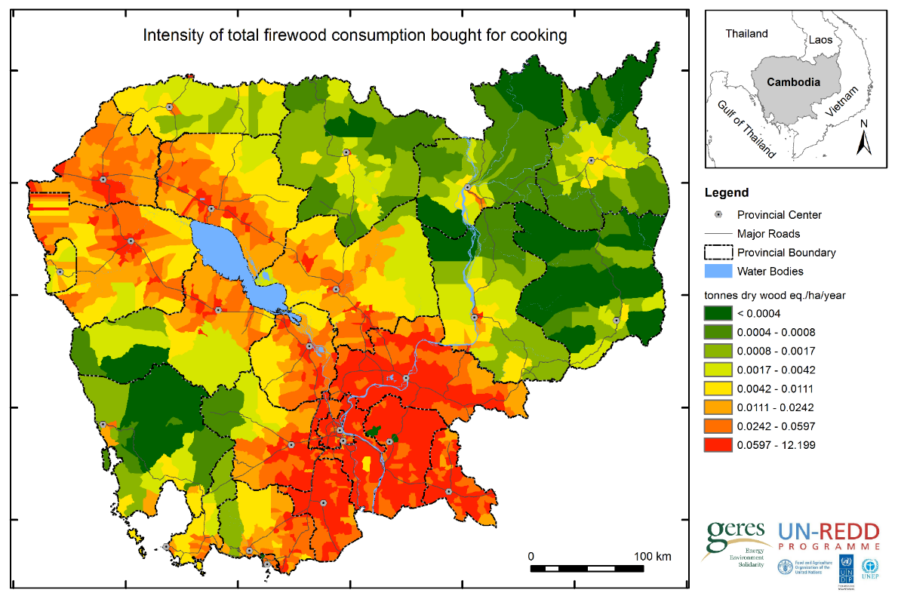
Annual woodfuels demand in Cambodia

Slide 15
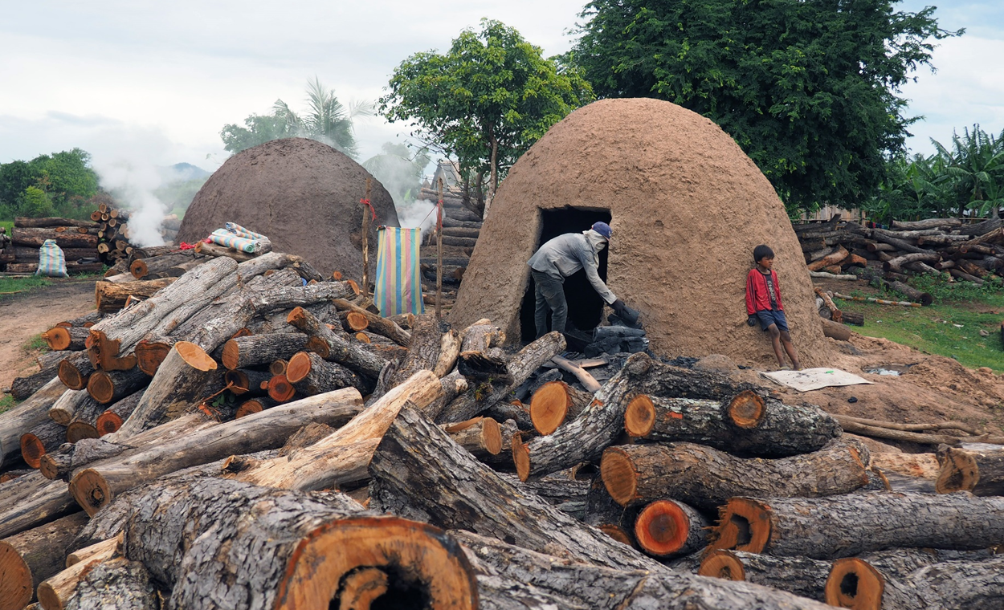
Annual woodfuels demand in Cambodia
3,000,000 tonnes of wood cut for charcoal production
Notes:
ធ្យូងដែលផលិតបានគឺផ្គត់ផ្គង់ឲតែតម្រូវការតាមផ្ទះប៉ុណ្ណោះ។

Slide 16
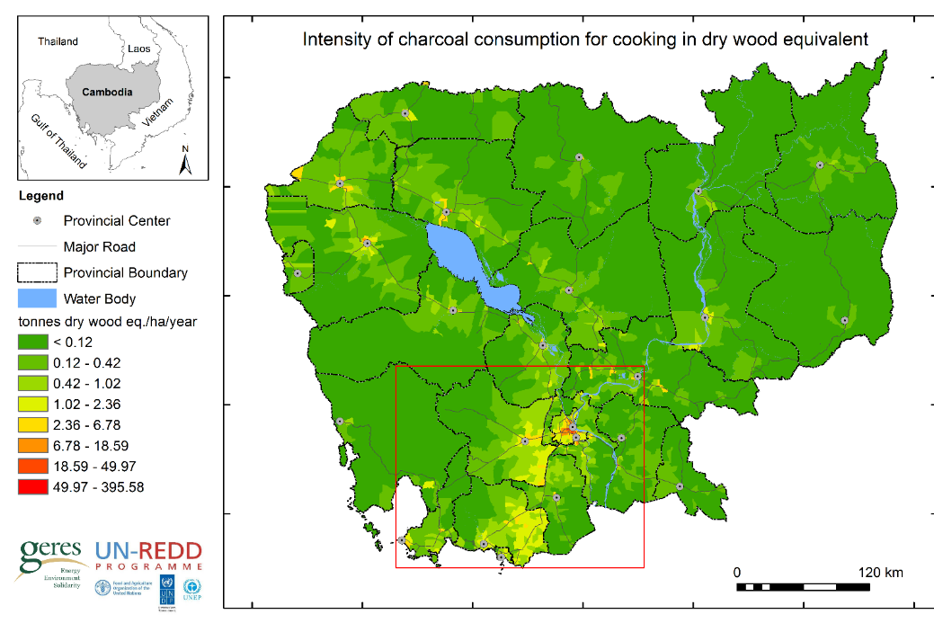
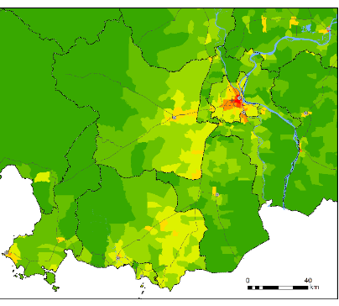
Annual woodfuels demand in Cambodia

Slide 17
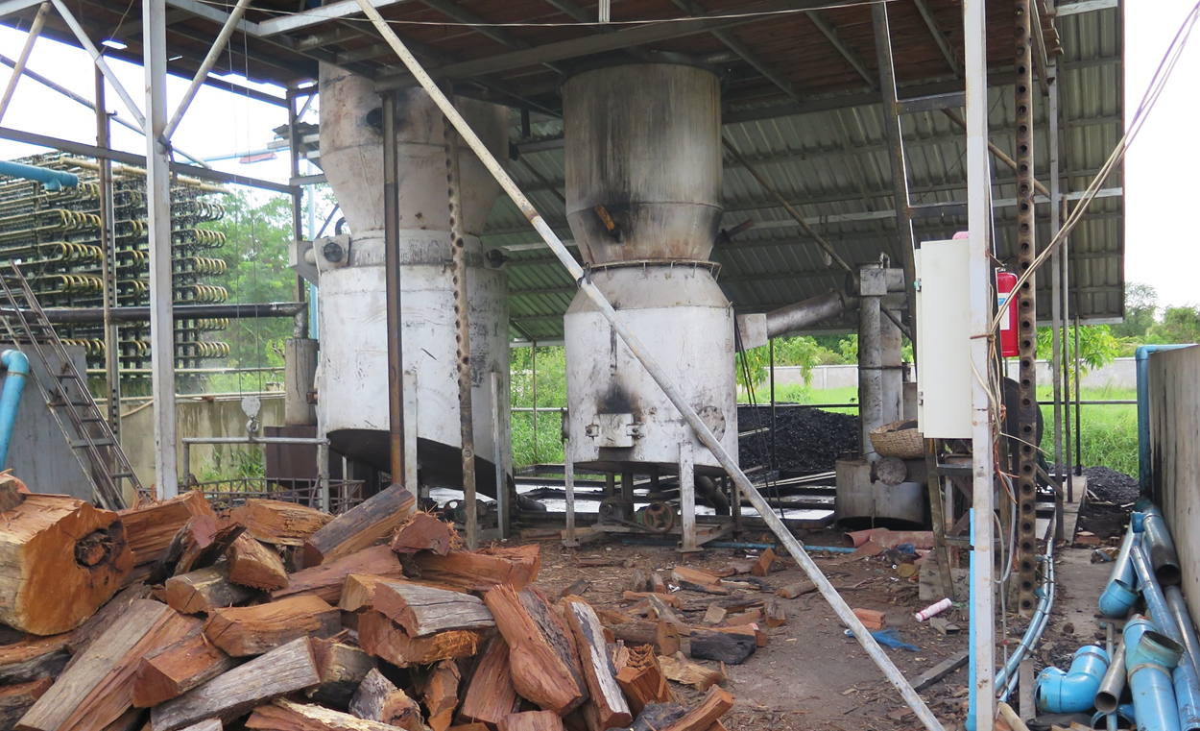
Annual woodfuels demand in Cambodia
780,000 tonnes cut annually for industrial activities

Slide 18
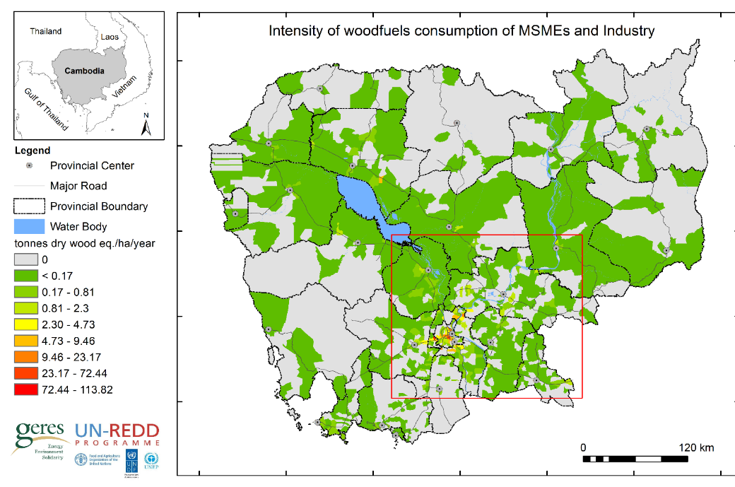
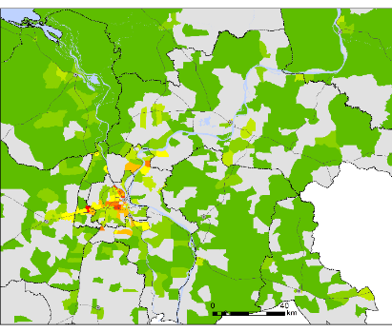
Annual woodfuels demand in Cambodia

Slide 19
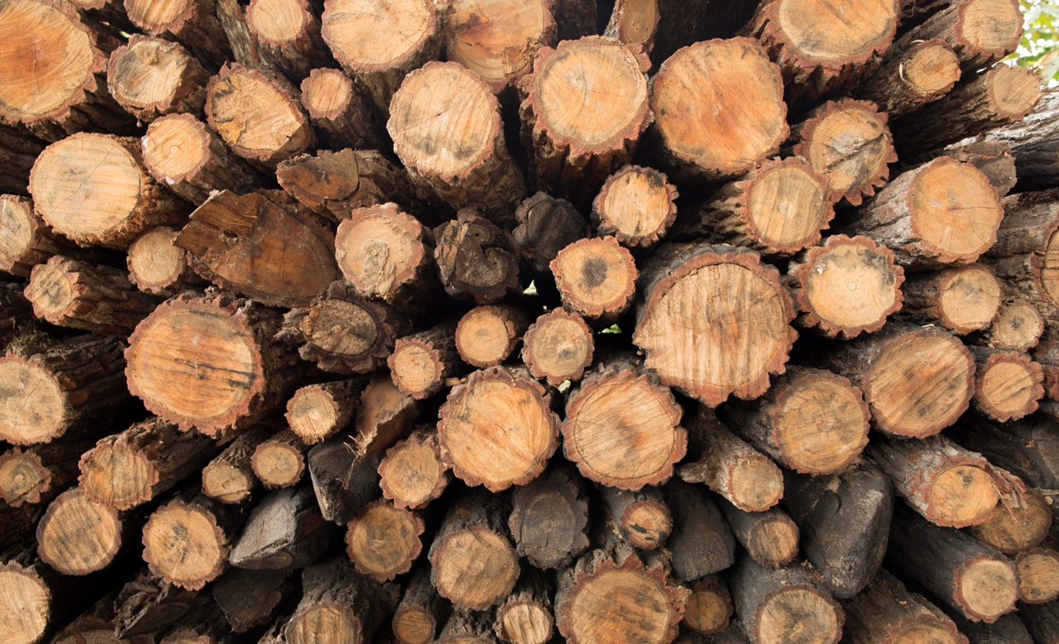
Annual woodfuels demand in Cambodia
5,500,000 tonnes of wood cut for woodfuels consumption

Slide 20
Impact of woodfuels on forest

Slide 21
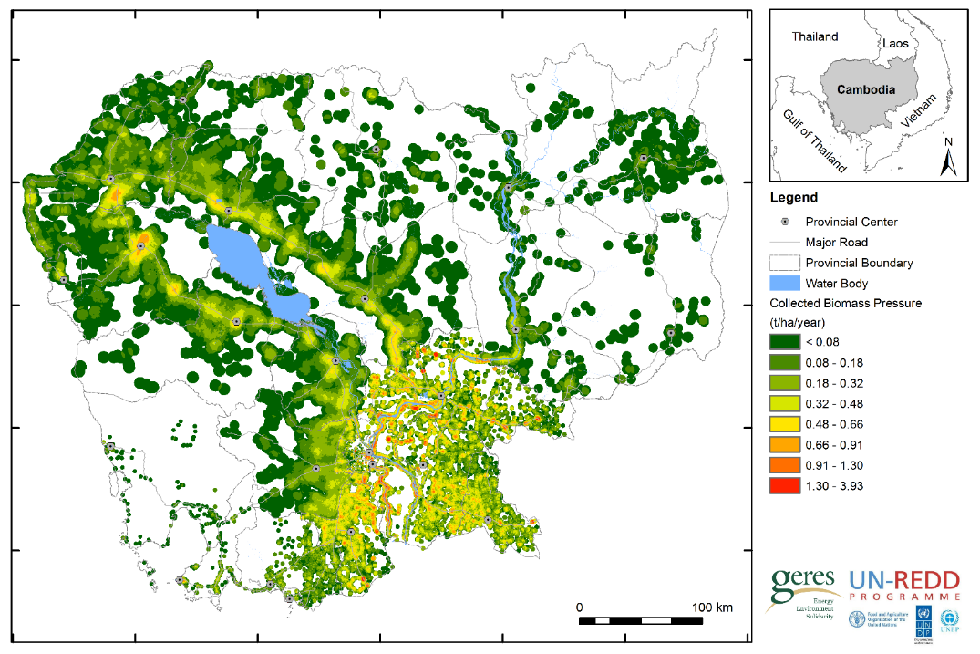
Pressure of wood collected by end-users over forest and non-forest
11% of wood is collected from forest by wood consumers
Notes:
Place where wood is collected and quantity of wood which is collected by villagers/wood consumers

Slide 22
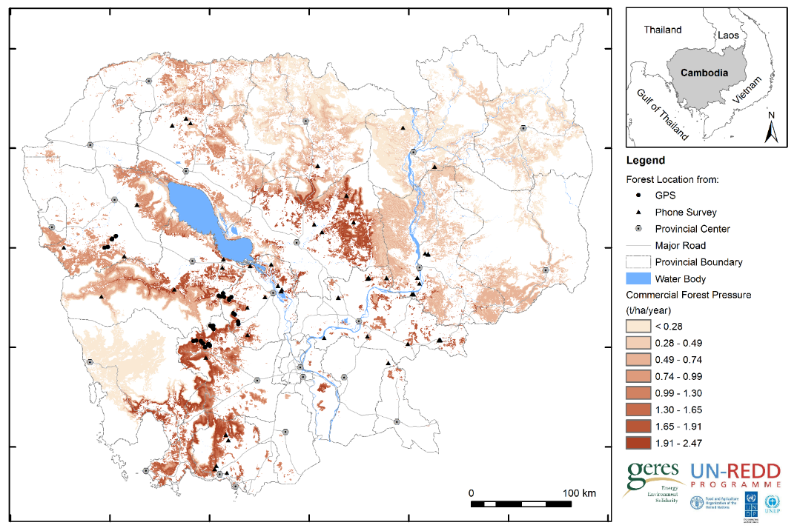
Pressure of charcoal and purchased firewood over forest
Charcoal is responsible for 62% of the pressure of commercial woodfuels
Notes:
Woodshed = កន្លែងដែលមានសក្តានុពលក្នុងការផ្តល់ឈើសម្រាប់ធើ្វជាធ្យូង និងឈើសម្រាប់លក់ឲ្យរោងចក្រ សហគ្រាសនានា​ នៅទូទាំងប្រទេស

Slide 23
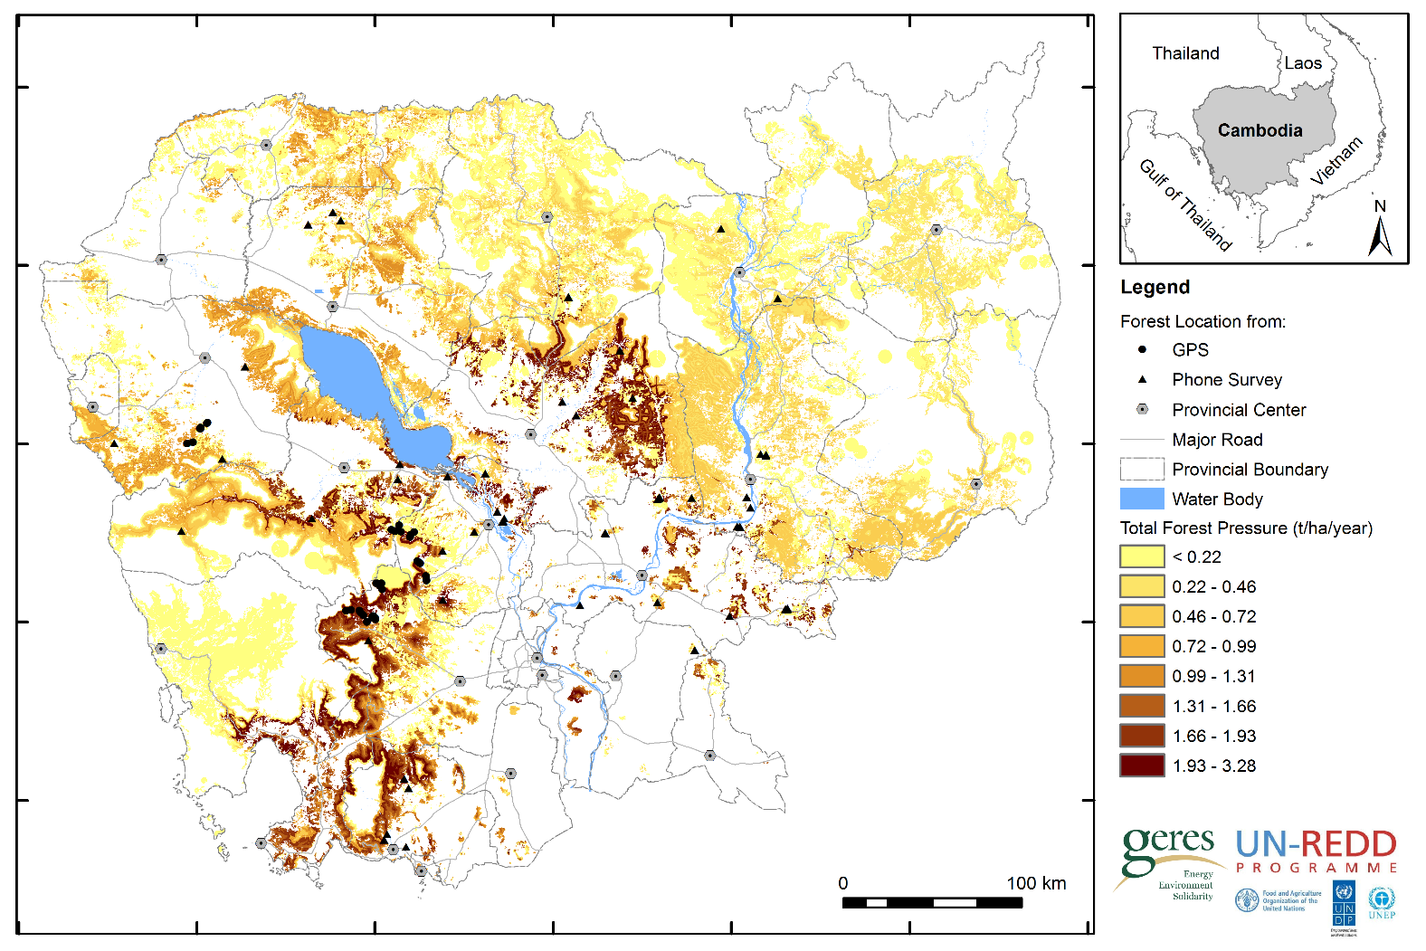
Annual woodfuels pressure on forests
3,400,000 tonnes of woodfuels are originated from forest, 73%
Notes:
សរុបបរិមាណាឈើដែលដកហូតពីព្រៃ (ឈើប្រមូលដោយប្រជាជនសម្រាប់ប្រើប្រាស់ក្នុងផ្ទះ ឈើសម្រាប់ធ្វើធ្យូង ធ្វើអុសលក់ឲ្យរោងចក្រសហគ្រាស) មានចំនួន ៣.៤​លាន​តោន ឬស្នើរនឹង ៧៣%នៃតម្រូវការអុសធ្យូងនៅទូទាំងប្រទេស

Slide 24
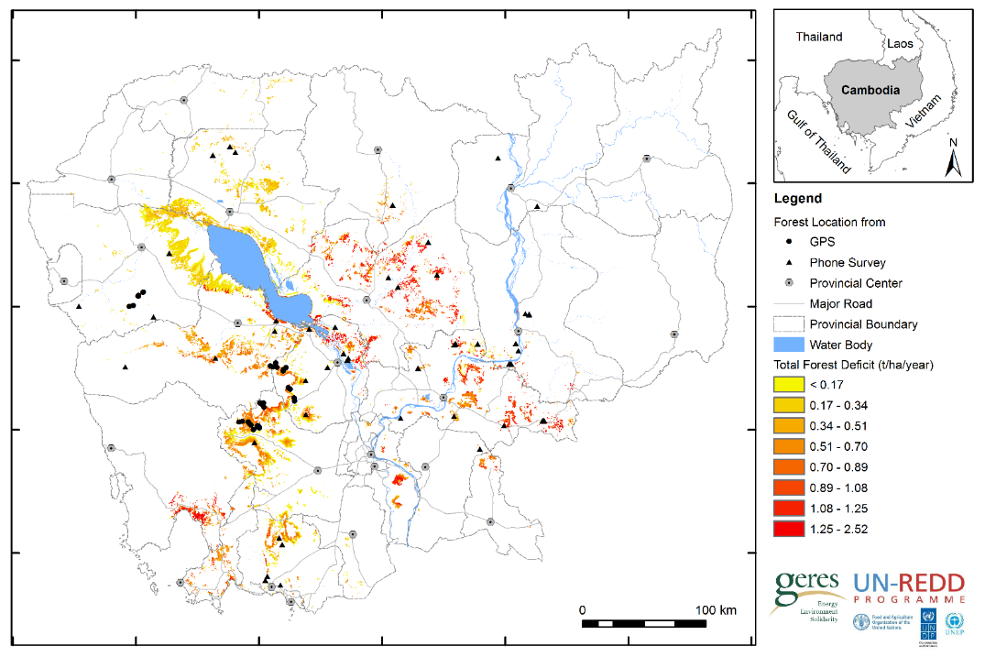
Forest degradation areas from national woodfuels consumption
380,000 tonnes of woodfuels exceeding from the supply
Notes:
38 ម៉ឺនតោន ជាបរិមាណជីវម៉ាស់ដែលដកហូតលើសប្រមាណ គឺលើសពីអ្វីដែលព្រៃអាចផ្តល់ឲ្យបាន ដូច្នេះវាត្រូវបានចាត់ទុកថាជាជីវម៉ាស់ដែលមិនកើតឡើងវិញ

Slide 25
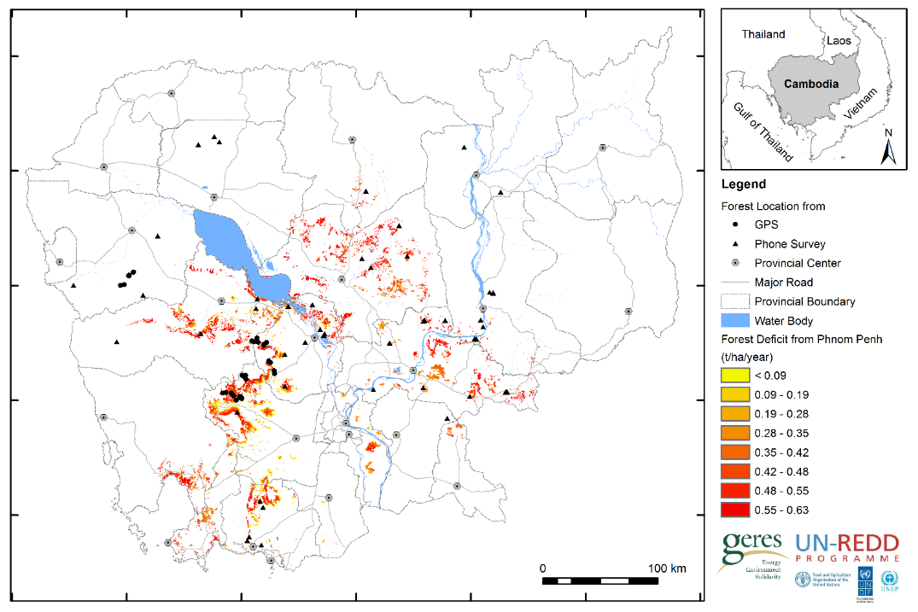
Forest degradation areas from Phnom Penh consumption
50% of total over-harvested amount is due to the demand from Phnom Penh

Slide 26
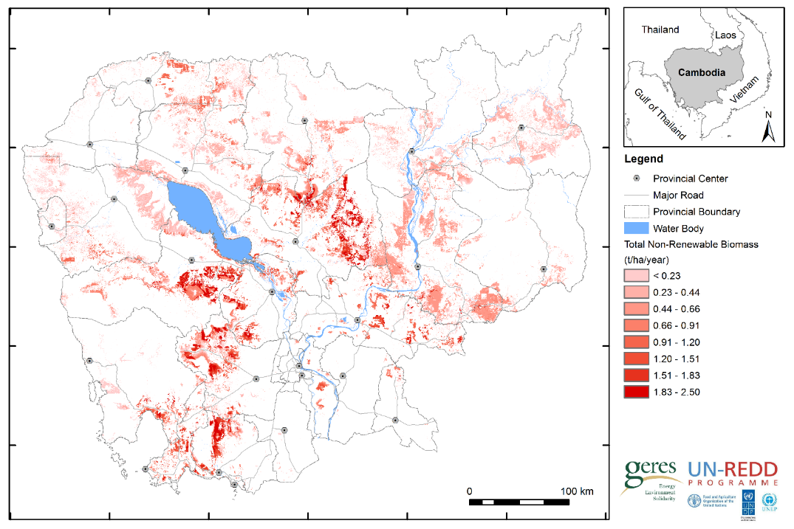
Total Non-Renewable woodfuels consumption
1,200,000 tonnes of woodfuels biomass is not sustainable

Slide 27
Currently the majority of non-renewable woodfuels is supply forest-to-agriculture land conversion
Woodfuels exceeding from the supply
Woodfuels from forest-to-agriculture land conversion
32%
68%

Slide 28
‘So what will happen when conversion of forests to agricultural land will no longer supply the woodfuels demand?’

Slide 29
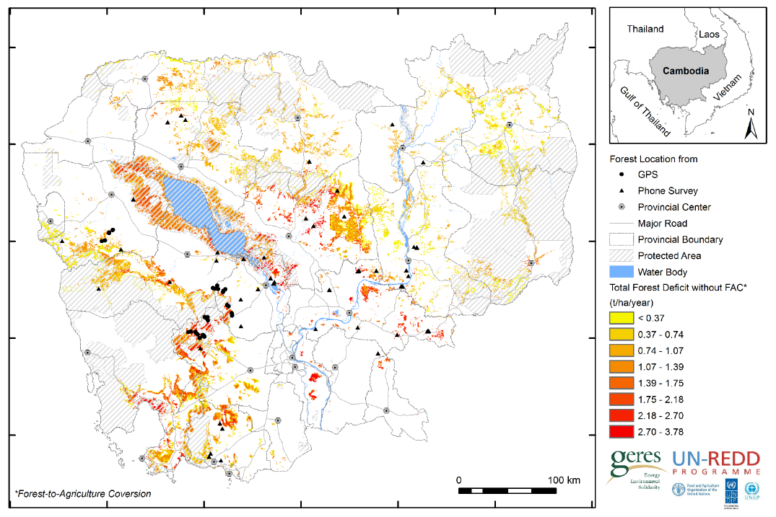
Over-harvested hotspot without the supply from deforestation
1,800,000 tonnes of NRB and 49% found inside protected areas

Slide 30
Strategies to tackle woodfuels pressure
Increase energy efficiency with:
Improved cookstove for households
Energy efficient technologies for industries
Improved charcoal kiln for charcoal producers
Increase the amount of supply via:
Sustainable forest management in Community Forestry;
Afforestation/reforestation using short-rotation plantations (Acacia, Bamboo…)
Agro-forestry practices;
Energy substitution:
Agriculture by products - rice husk, coconut shells, corn cobs, cane sugar residues, peanut shells, saw dusk.
LPG, Biogas, Solar

Slide 31
Simulation of strategic planning to reduce NRB
Example of Current Situation | Action/Project | Possible Result
1. Improved cookstove efficiency/ជំរុញឲ្យមានការប្រើប្រាស់ចង្ក្រានប្រណិតតាមគ្រួសារ
Current number of HH using charcoal stoves (numbers) | Share of HH switching to energy efficient technologies (KhROS: - 20%) | Wood saved (t/year)
1,000,000 |  | -
2. Energy efficiency for Industry/MSMEs / ជំរុញឲ្យមានការប្រើប្រាស់បច្ចេកទេសដែលសន្សំសំចៃថាមពលតាមរោងចក្រ ឬសហគ្រាសដែលប្រើប្រាស់ជីវម៉ាស់សម្រាប់ផ្គត់ផ្គត់ថាមពល
Current wood consumptions for industry activities (t/year) | Share of industries switching to energy efficient technologies (Average: - 20%) | Wood saved (t/year)
780,000 |  | -
3. Charcoal kiln efficiency / ជំរុញឲ្យមានការប្រើប្រាស់ឡធ្យូងប្រណិតតាមកន្លែងផលិតធ្យូងបុរាណ
Current wood consumptions for traditional charcoal production (t/year) | Share of traditional charcoal producers switching to energy efficient technologies (Improved Charcoal kilns: -20 %) | Wood saved (t/year)
3,000,000 |  | -
4. Energy substitution -> Ex: Ricehusk Briquette / ជំរុញឲ្យមានការប្រើប្រាស់ថាមពលជំនួស ឧ. ដុំធ្យូងអនាម័យធ្វើពីអង្កាម
Current ricehusk briquette product (t/year) | Quantity increase (t/year) | Wood saved (t/year)
10,000 |  | -
5. Increasing potential supply / ពង្រីកសក្តានុពលនៃការផ្គត់ផ្គង់ ផ្តោតសំខាន់លើតំបន់ជាប្រភពសម្រាប់អុស ធ្យូង
Current community forestry area (ha) | Increase in Community Forestry areas with Enrichment planting/Assisted Natural Regeneration (%) | Annual supply increase (t/year)
300,000 |  | -
Notes:
Improved cookstoves : KhROS = khmer rocket stove

Slide 32
Vannareth Huoy (Ms.)
v.huoy@geres.eu
Thank You
Website: http://www.geres.eu

