Slide 1




Quantifying Drivers of Deforestation and Forest Degradation and Related Future Trends
Paul Gager
Aruna Technology Ltd

Slide 2
Background
Cambodia has been proactive to adopt UNFCCC COP decision known as REDD+
UN-REDD in Cambodia supports implementation of REDD+ readiness roadmap
REDD+ MRV requires countries to submit information on drivers of deforestation and degradation
UN-REDD programme and FAO have devised studies to assess the drivers of deforestation and forest degradation and in Cambodia also specifically on woodfuels.

Slide 3
Background
FAO engaged Aruna to support the development of Cambodia RL/REL framework
Methodology for quantifying deforestation and degradation and in particular forest cover change and related future trends.
Aim to provide recommendations to support ongoing quantification of drivers by RGC
6 week project, commencing in Aug 2015

Slide 4
Scope
Collect data to perform quantitative analysis
Develop a methodology for quantitative analysis of drivers of forest cover change
Perform a quantitative GIS analysis
Report results and compare finding to woodfuels study

Slide 5
Data sources
Activity data
Human activity resulting in emissions
Tier 3 approach requires spatial information on land use categories
“Wall to Wall”
Main source is forest cover data from FA

Slide 6
Driver Data
Needs to be “spatially explicit” i.e. need to identify locations and areas
Wide range of drivers of change from agro-industry to agricultural expansion to infrastructure development
A number of previous studies completed; some provide estimates but few include spatial info
Some data can be hard to obtain as it is generally not public and held by multiple agencies.
Other data is complex and hard to collect

Slide 7
Activity Data
Land Use mapping
Currently being finalized by FA
Years 2005, 2010 and 2014
Will be the basis for RL/REL reporting
Contains 22 classes

Slide 8
Classification scheme
ID | Class Name | Code
1 | Evergreen Forest | E |  | 12 | Palm Oil Plantation | Po
2 | Pine Forest | P |  | 13 | Pine Plantation | Pp
3 | Bamboo | B |  | 14 | Crop generic (Agriculture) | Hc
4 | Forest regrowth | Fr |  | 15 | Paddy Rice | Hr
5 | Semi-evergreen forest | Se |  | 16 | Built Up Area | B
6 | Deciduous Forest | D |  | 17 | Village | Bt
7 | Mangrove Coastal | M |  | 18 | Grass | G
8 | Mangrove rear | Mr |  | 19 | Woodshrub | Ws
9 | Flooded Forest | Ff |  | 20 | Rock outcrop | R
10 | Tree plantation | Tp |  | 21 | Sandy Beach | S
11 | Rubber plantation | Rp |  | 22 | Water | W

Slide 9
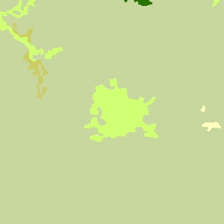
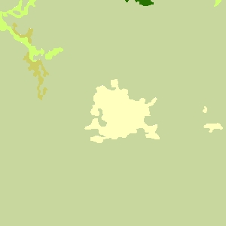
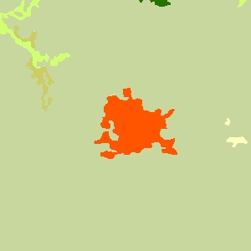
Change Detection
RGC will use post-classification change detection
Two LU/LC maps are generated and compared to detect change
Technique is straightforward but sensitive to inconsistencies in classification in interpretation
A high accuracy is required to avoid identifying “false change”
Incorrect
Early Year
Later Year
False Change

Slide 10
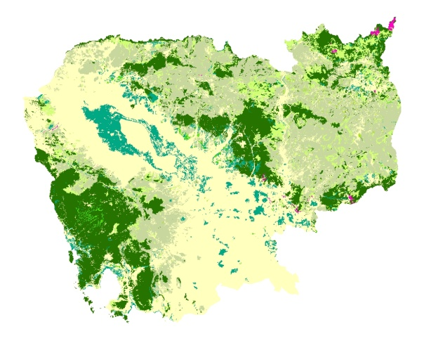
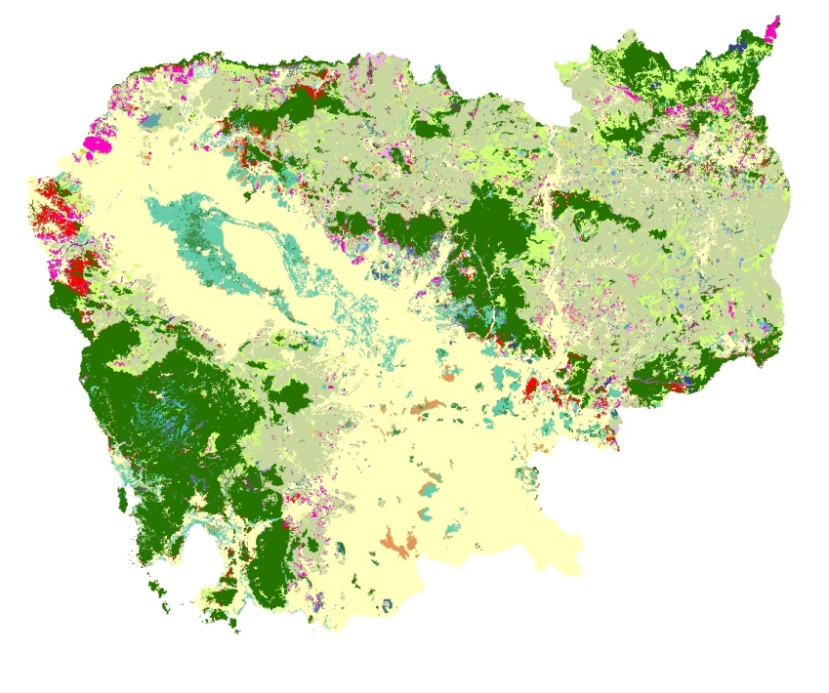
Change detection
Early year
Later year
Change Image

Slide 11
Simple Change Matrix
 |  | Initial
Final |  | Forest | Non-forest | Final Area
 | Forest | 5,000 | 100 | 5,100
 | Non-forest | 800 | 2,000 | 2,800
 | Initial Area | 5,800 | 2,100
 | Change | -700 | +700

Slide 12
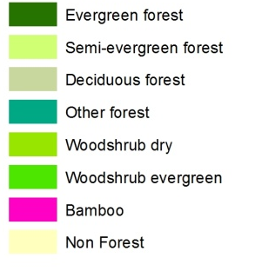
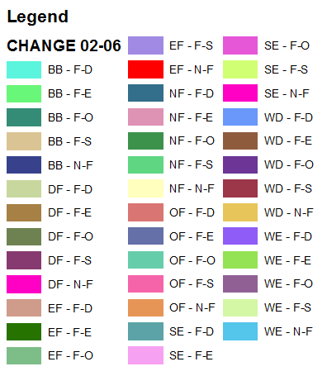
Change detection
Early year
Later year
Change Image

Slide 13


Difficult to visualize change
Many combinations 8 x 8 = 64 classes
Early Year
Later Year

Slide 14
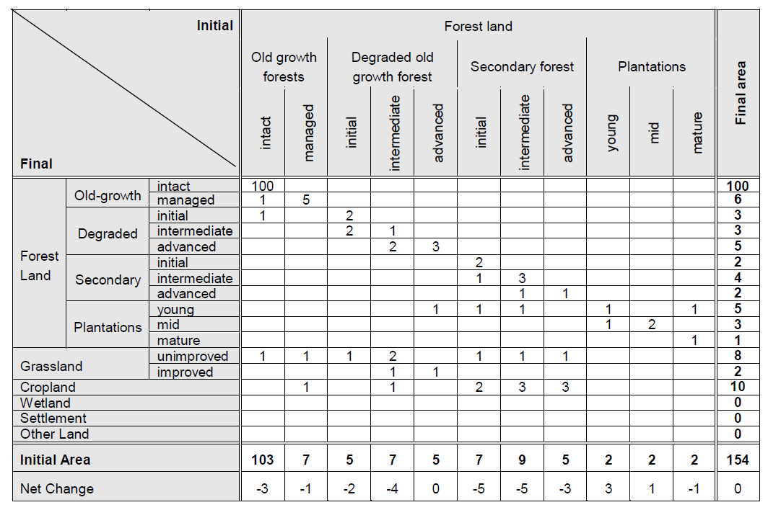
Change Matrix
A more comprehensive summary

Slide 15
Driver Data
Why quantify driver data ?
Part of UN-REDD obligations
Support decision making
3 main drivers of deforestation identified by UN-REDD
Conversion of forest lands: ELCs, SLCs, mining etc
Forest land encroachment: land speculation/grabbing
Unsustainable harvesting

Slide 16
Economic Land Concessions (ELCs)
Up to 10,000 Ha
Normally require decision by Council of Ministers
Around 2 mill Ha of concessions have been awarded
Administered by MoE and Forestry Administration
No new ELCs since 2012

Slide 17
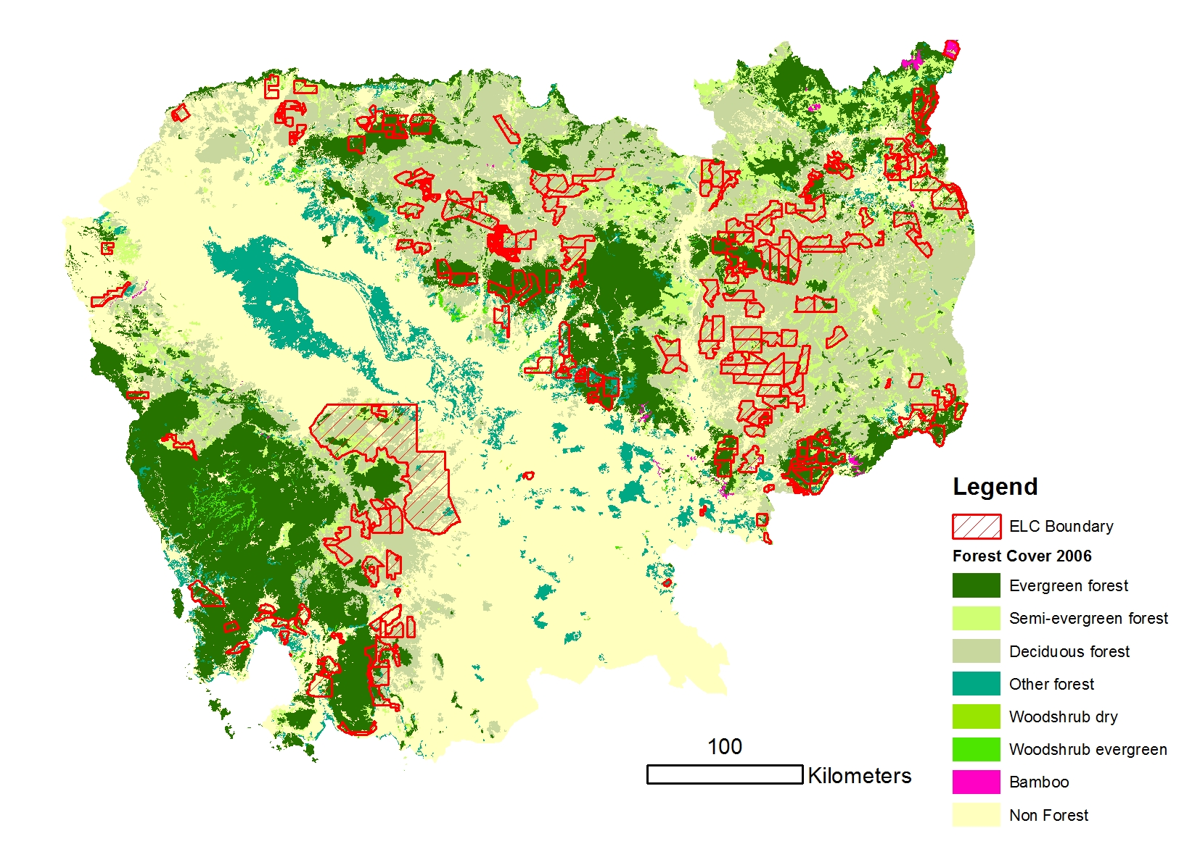
ELC Location Map

Slide 18
ELC Data
Data is not always available publicly
Status of ELCs changes from time to time e.g. Area reduced, cancelled etc
RGC will prepare updated list for RL/REL reporting
For present study, various public sources were used with some edits

Slide 19
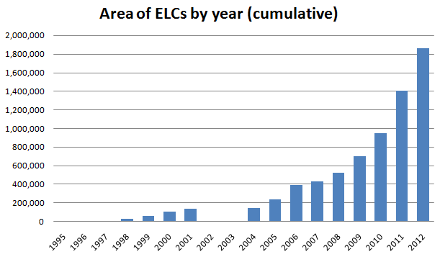
ELCs by year

Slide 20
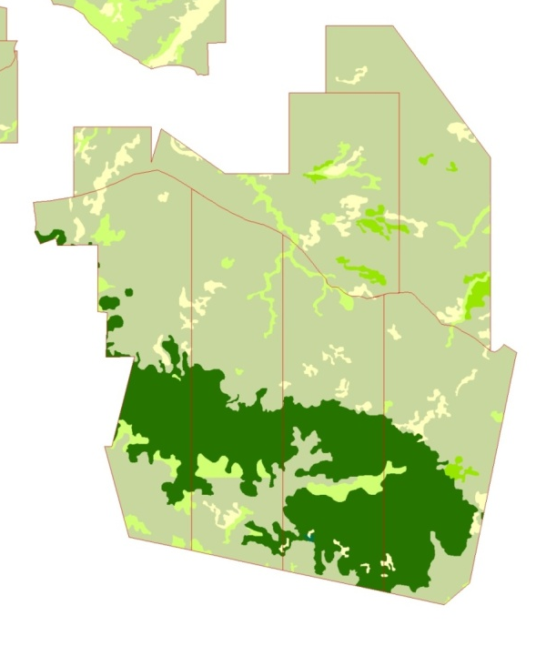
Activity data & ELCs
Relatively straightforward using GIS overlay analysis
Summarize and present
Activity data not yet available so summary based on 2006 FC data was undertaken

Slide 21
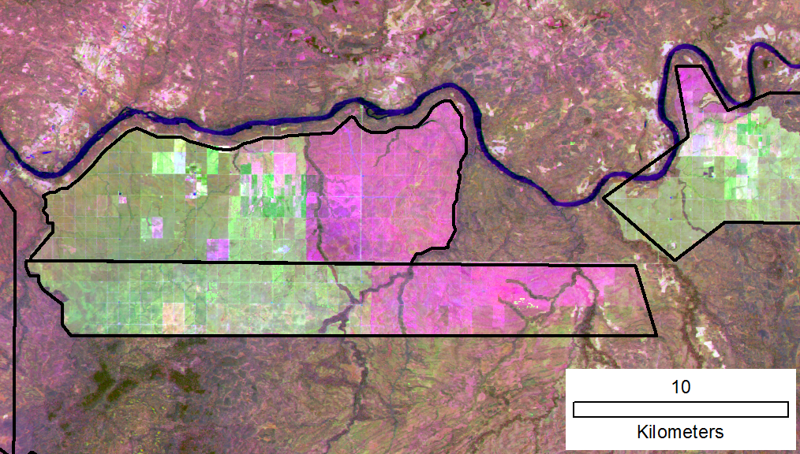
Present Forest Cover in ELCs
Visual assessment based on 2015 satellite imagery

Slide 22
Present Forest Cover in ELCs
Results of visual assessment

Slide 23
Clearing Activity 2014-2015
Visual assessment of ELCs with >50% forest cover
24 concessions (about 10% of total no.) had no clearing activity
Based on this activity level it could be assumed therefore that most of the current ELCs will be cleared in future.

Slide 24
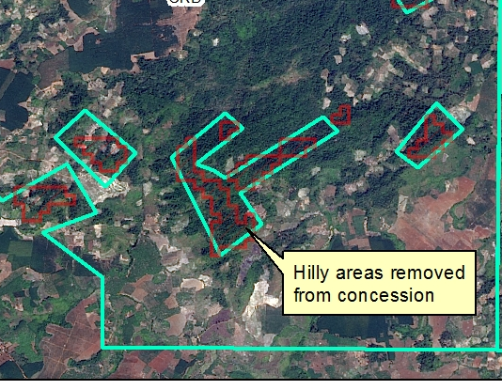
Hilly Areas
Hilly areas often not part of concession area
What is the potential for development, based on slope, landform ?

Slide 25
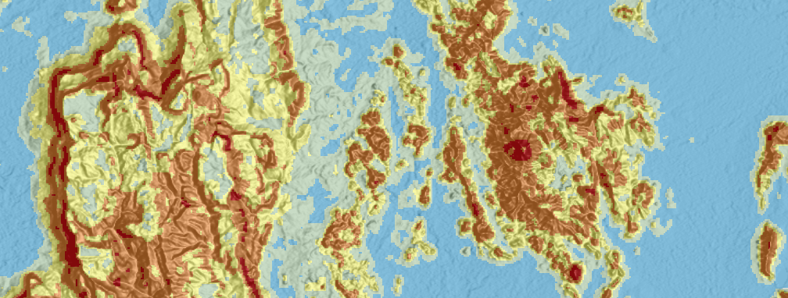
Watershed Classification (WSC)
Potential degradation risk when cleared of the original vegetation cover
Considers slope and soils
Data available from Mekong River Commission

Slide 26
WSC of ELCs
Most susceptible classes Class 1 and 2
Only make up 2.9% of the ELC area
WSC Class | Ha | %
1= Protection Forest | 5,482.14 | 0.3%
2 = Commercial Forest | 50,651.31 | 2.6%
3 = Agro-Forestry | 130,708.07 | 6.8%
4 = Upland Farming | 534,761.06 | 27.6%
5 = Lowland Farming | 1,212,881.75 | 62.7%
Total | 1,934,484.33 | 100%

Slide 27
Infrastructure Development
Direct impacts
Hydropower
Roads
Industry
Indirect impacts
Improved road access allows settlement of new areas and removal of natural resources

Slide 28
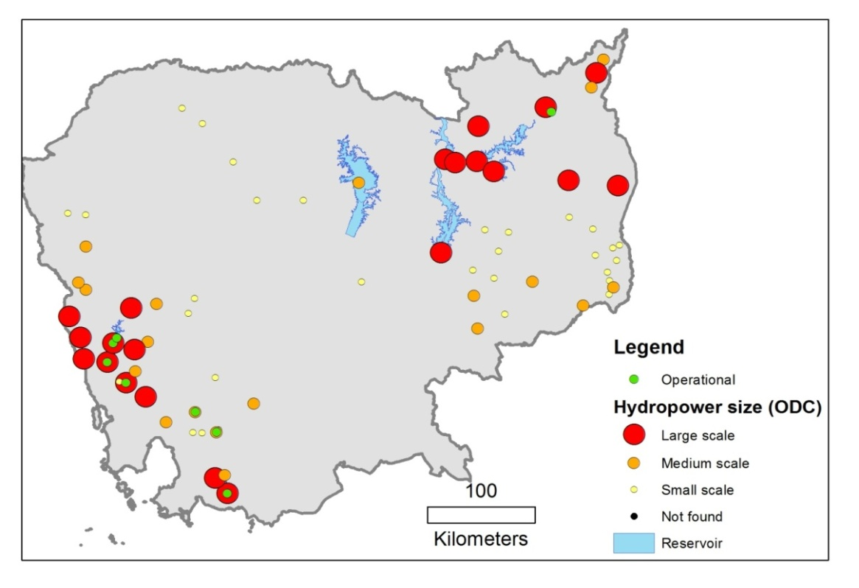
Infrastructure - Hydropower
8 schemes in operation, 1 under construction
Only around 10,000 ha inundated so far
Numerous other schemes being studied
Likelihood of construction varies; depends on economic, social and environmental factors
Upper estimate of 300,000 Ha potentially flooded

Slide 29
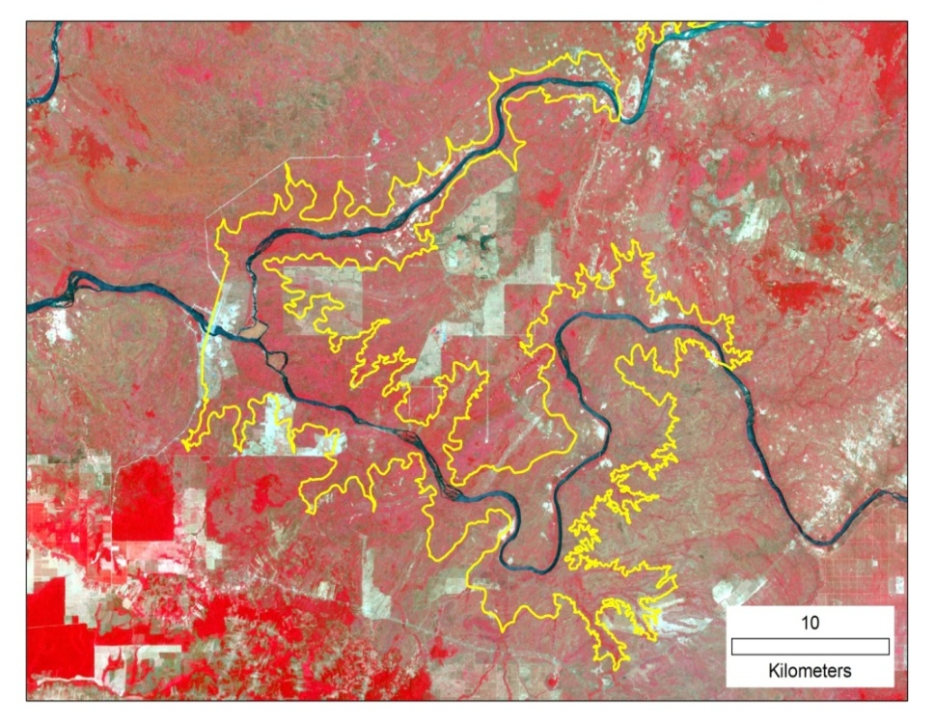
Impact on forest
Depends on topography
Low Sesan II (400 MW) will flood 30,000 Ha of forest
Kamchay (190 MW) reservoir area is 2,000 Ha

Slide 30
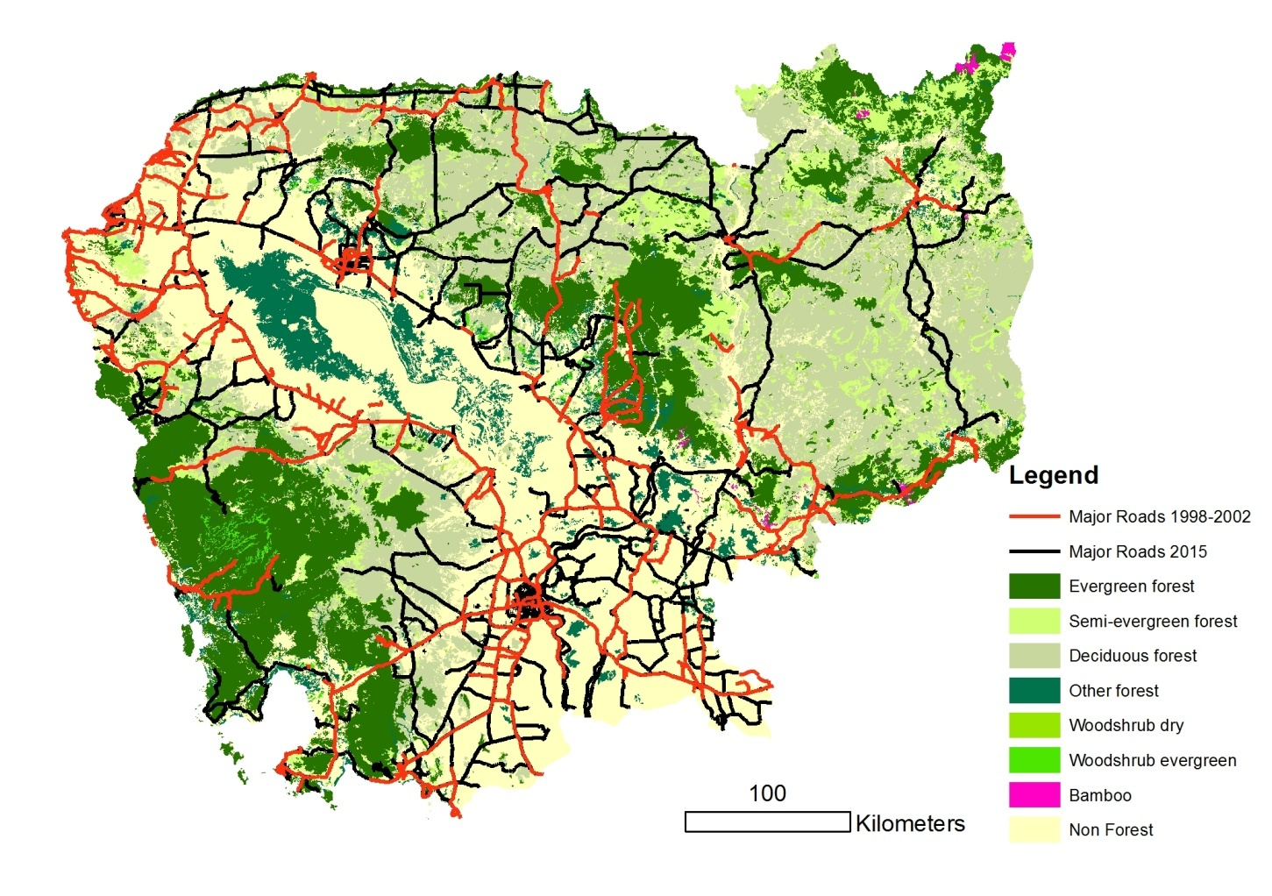
Road Development

Slide 31
Roads
Generally speaking the DIRECT impact of roads is low e.g. 100 km of road with 30m corridor is 300 Ha of land area
Estimate 1,300 km of new major roads 1998 to 2002 affecting a land area of 40,000 Ha
Indirect impacts e.g. improved access are likely to be much higher, driven by demand for agricultural land

Slide 32
Woodfuel Study - GERES
Models demand, supply and access
Identifies areas where woodfuel extraction is likely
Actual extraction in reality may be more concentrated
Quantifying the contribution to deforestation may be difficult, spatially

Slide 33
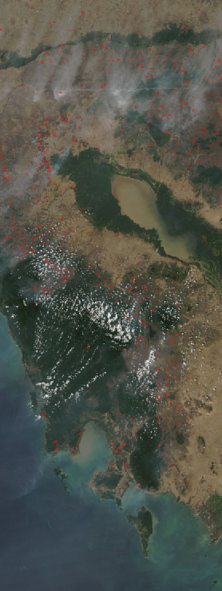
Monitoring - Fires
Fires are drivers themselves
Also indicate of land conversion
MODIS Active fire product
Current and historical data can be downloaded for free
Daily overpass by satellite

Slide 34
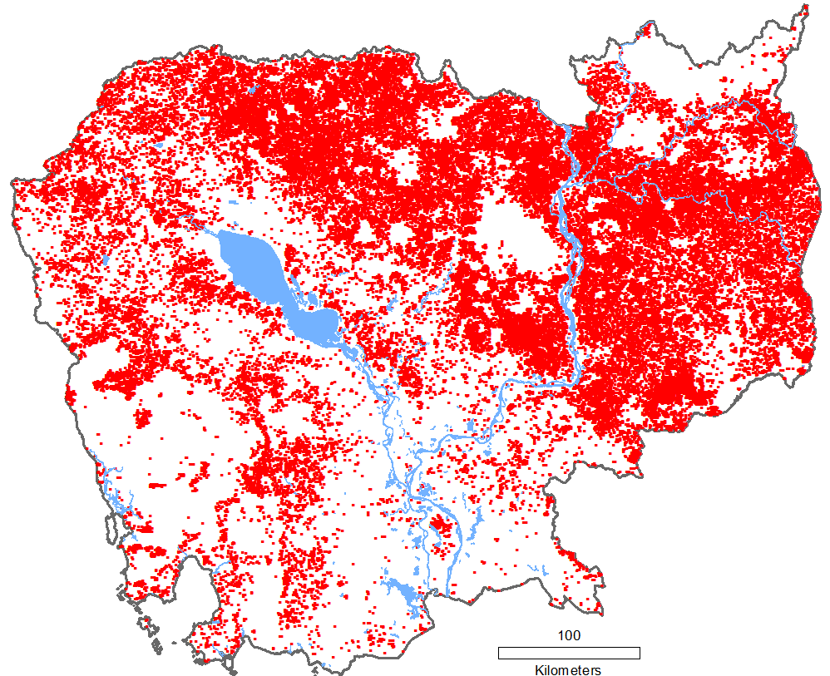
Fires 2014 - 15
Data from 1/1/14 to 09/05/15
74,000 observation points
Attributes
Confidence
Brightness
Radiative power

Slide 35
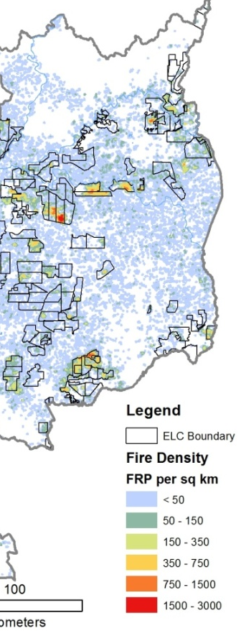
Data Visualization
Density map
FRP per sq km
Shows fire intensity over the time period
Fires widely distributed, but most intense inside ELCs
35% of total energy release inside ELCs

Slide 36
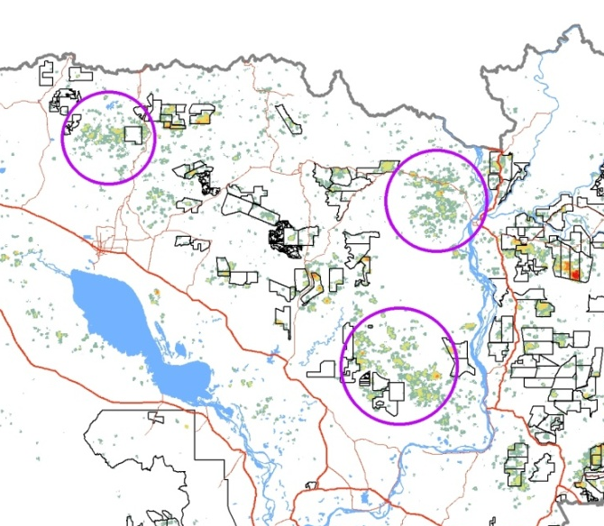
Other areas of fire activity
Three large areas of burning activity were observed
Likely a result of agricultural expansion

Slide 37
Fire Data Limitations
Fire may obscured by cloud, canopy cover
Fire may be too small or too cool to be detected (<1,000 m²)
Conclusion: Fire data may be incomplete but will give an idea of areas of high activity and low activity

Slide 38
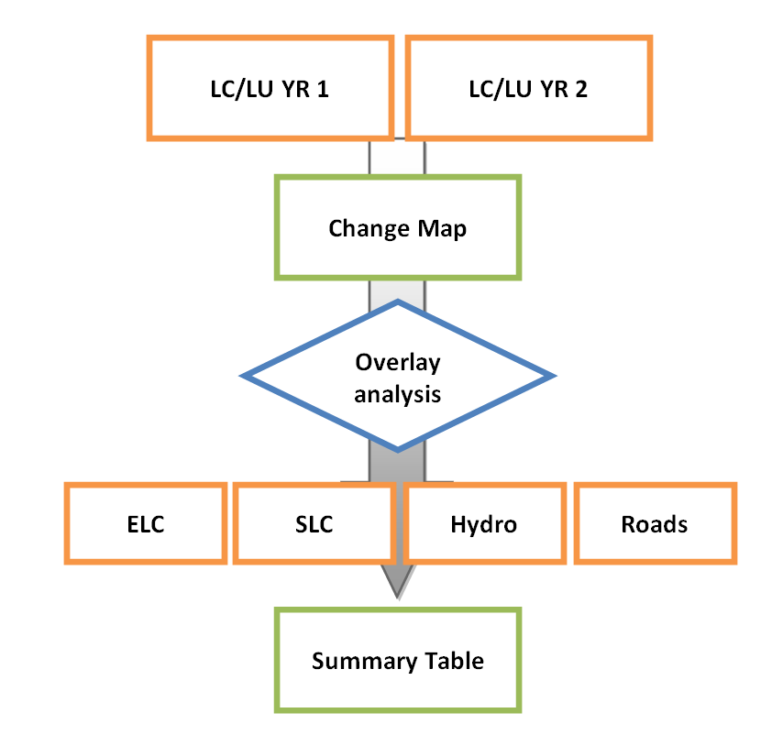
Analysis Framework

Slide 39
Example Summary Table
Hypothetical summary
Driver | Ha | Mt of CO2 | % of carbon emitted
ELC | 400,000 | 78 Mt | 50%
SLC | 150,000 | 29.25 Mt | 18.8%
Hydropower | 20,000 | 3.9 Mt | 2.5%
Roads (direct) | 5,000 | 0.975 Mt | 0.6%
Sub-total | 575,000 | 112.25 Mt
Total converted area | 800,000 | 156 Mt
Balance | 225,000 | 43.85 Mt | 28.1%

Slide 40
“Balance” areas
Deforestation is not attributable to one of the main drivers
Additional analysis could include;
Buffering village locations
Consider adjacency to known drivers e.g. ELC
Consider woodfuel demand areas
An area may have multiple drivers affecting an area e.g. Timber production, woodfuel and agricultural expansion.

Slide 41
Future Trends - ELCs
In 2006:
1.6 mill. Ha. of forest inside ELCs
82.9 % Forested
396,000 Ha Evergreen forest
In 2015:
Clearing of ELCs is well underway
There are few physical constraints on clearing
What will be the impact of ELCs on forest cover in future ?

Slide 42
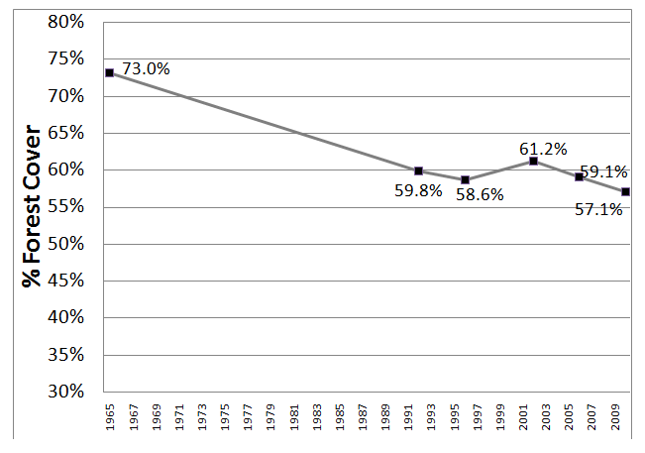
Historical Forest Cover

Slide 43
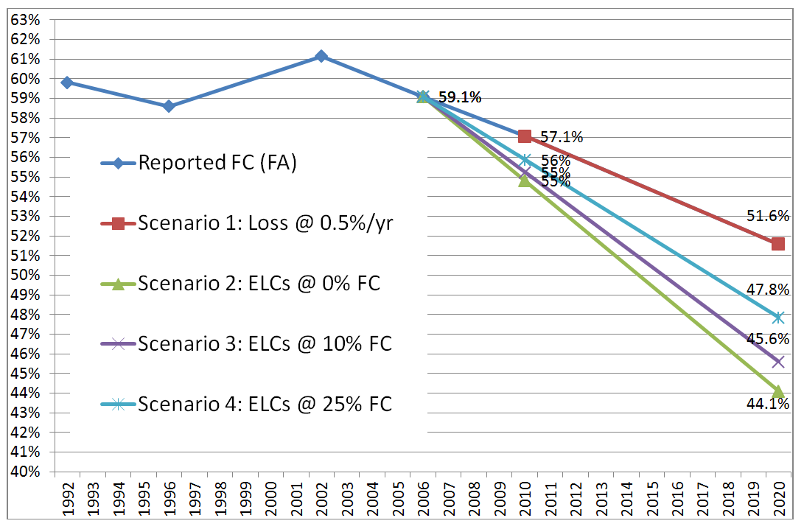
ELC Clearing Scenarios
2006 forest cover as baseline
Notes:
Scenario 1: Includes forest plantations

Slide 44
Monitoring
Cambodia may opt for biennial (2 year) or 4 year reporting
Activity data is required for reporting
National REDD strategy seeks to address drivers in 2016-2020
What else can be done to monitor situation to gauge effectiveness of policy etc and take actions ?

Slide 45
Conclusions
Methodology can be applied once the activity data is finalized
Some drivers are more easily quantified than others
It may be difficult to separate the drivers from each other at specific locations
The situation is changing rapidly and monitoring and quantification needs to be regularly updated

Slide 46
Thank you !

