Slide 1

Session 10: Linking CBR+ with National REDD+ Programme in Cambodia
Training of Trainer on REDD+ Concept for UNDP GEF SGP/CBR+ Grantees
7 October 2015

Slide 2
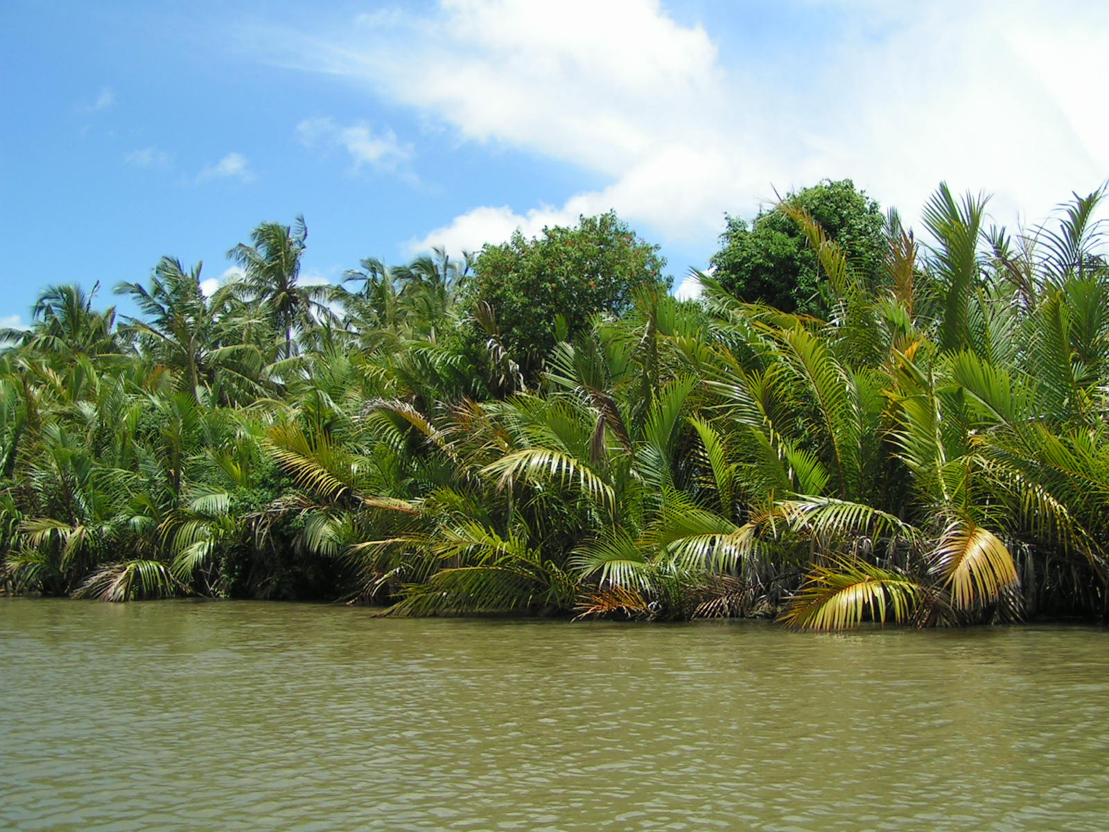
Learning Objectives
By the end of the session, participants will understand
What CBR+ is and how it is implemented
Synergies between GEF SGP and UN-REDD Programme and National REDD+ Programme in Cambodia
How CBR+ contributes to the implementation of the National REDD+ Strategy

Slide 3
Overview of CBR+
Grants of up to $50,000 designed to familiarize stakeholders at the community level with REDD+; support to learn about, engage with, and influence on-going national REDD+ readiness processes.
CBR+ is being delivered by UNDP, using SGP’s existing country-based grants delivery mechanism
Funded activities will align with national REDD+ strategies and priorities
6 pilot countries globally: Cambodia and Sri Lanka in Asia-Pacific
Notes:
Note to Celina: Be ready to answer the question of where the SGP co-financing comes from. Answer: Matching grant funding from complementary SGP thematic areas like land degradation and climate change, which would be disbursed in line with the CBR+ Country Plan. Also, in kind contribution in the form of staff time, use of premises, equipment etc.

Slide 4
Overview of CBR+ Implementation
SGP National Coordinator
CBR+ National Steering Committee in Cambodia
Existing SGP National Steering Committee + 4 representatives from national REDD+ bodies
HE Chea Sam Ang, DDG of FA, MAFF
HE Choup Paris, Deputy Sec-Gen, National Council of Green Growth, MoE
Ms Teng Rithiny, CSO representative, REDD+ Consultation Group
Mr Chheurt Chhorn, IP representative, REDD+ Consultation Group
CBR+ Country Plan
Guiding doc to select projects and ensure link with national level work on REDD+ readiness
Notes:
At the country level, CBR+ is being managed by SGP’s National Coordinators (UNDP staff experienced in managing small grant processes at the country level), working closely with UN-REDD staff who are providing technical guidance and ensuring robust links to UN-REDD processes.
SGP National Steering Committees are already in place in SGP countries. For CBR+, these have been supplemented with REDD+ expertise from the National Programme steering committees and IP/CSO platforms to form CBR+ National Steering Committees. CBR+ NSCs will approve CBR+ Country Plans and will select grantees. The precise composition of each CBR+ NSC varies from country to country but [generally 3-4 additional members have been added – including] government, IP and CSO representation.
CBR+ Country Plan for Cambodia has been developed. The Country Plan outlines the approach for selecting grant recipients in each country, and ensure that the CBR+ grants complement ongoing REDD+ processes. [They also compliment the SGP Country Programme Strategies]

Slide 5
Collaborative Synergies - SGP
Very well-established national level infrastructure including National Coordinators and National Steering Committees
Over 20 years of experience working with communities through more than 16,500 community-based projects funded in over 125 developing countries.
Tried and tested, decentralized grant-disbursal mechanism

Slide 6
Collaborative Synergies – UN-REDD Programme
Supports countries to meet REDD+ under UNFCCC
Strong link to national REDD+ policy processes
Entry points for CBR+ projects to influence and promote policy changes
Technical expertise on REDD+
Through comparative advantages of UNDP, FAO and UNEP globally and regionally, and national REDD+ experts

Slide 7
Recap: Key Elements of REDD+ in UNFCCC
Drivers of deforestation and forest degradation and barriers to “+”
Policies and measures to address identified drivers and barriers to “+”
Notes:
A recap to help CBR+ grantees understand how their activities are linked to UNFCCC.
Highlight how understanding drivers of deforestation and forest degradation and barriers to “+” partly helps to identify what the “scope” (which of the 5 REDD+ activities) and “scale” (national and/or subnational) will be. Another important item linked to that are the policies and measures (PaMs) to address the drivers and barriers. CBR+ can help to test potential measures, e.g., actions/interventions. The results and experiences from these can be used to refine the NRS and improve its implementation.

Slide 8
National REDD+ Strategy
National REDD+ Elements
FREL/FRL
Safeguard Information System
NFMS
Body of analytical work, e.g., drivers of deforestation and forest degradation
Ground-based lessons and results
CBR+
Strengthen Effective Participation of Local Communities
Pilots to address drivers of deforestation & forest degradation
Notes:
This diagram illustrates the synergistic relationship between UN-REDD and SGP.
If necessary, quickly recap the 4 elements of Warsaw Framework: NS/AP, FREL/FRL; NFMS and SIS
The key point to highlight here is that CBR+ provides an opportunity to familiarize stakeholders at the community level with REDD+; support to learn about, engage with, and influence on-going national REDD+ readiness processes. This is done through (i) strengthening effective participation of local communities in national REDD+ processes; and (ii) pilot or test activities to address drivers of deforestation and forest degradation. For the latter, the experience through piloting will help to inform the future implementation of REDD+ activities.

Slide 9
Types | Drivers to be addressed between 2016-2020
Direct | Conversion of Forest Lands Economic/ Agricultural Development (e.g. ELCs) Settlements and Farm Lands (e.g. SLCs) Infrastructure Development (e.g. Road, Dam Constructions) Mining Forest Lands Encroachment Land Speculation/ Land Grabbing Illegal Loggings Unsustainable Forest Harvesting
In-direct | Limited governance in forest sector and land use sector Lack of coordination between ministries on land use planning Rural Poverty Low levels of stakeholder participation and involvement Lack of long term finance/ human resources to support forest sector Insufficient data and evidence to design effective forest crime prevention measures
Notes:
This slide is meant to highlight what the NRS has identified as key drivers that will be addressed. Suggest to briefly elaborate how these key drivers are prioritized, e.g., through literature, analysis as well as feedback from various stakeholders.
The objective is to prepare the grounds to understand the strategic objectives in the NRS and then link these objectives to the outcomes of the CBR+ country plan.

Slide 10
Linking CBR+ and NRS
CBR+ (summarized)
NRS
Outcome 1: Capacities of local community institutions and/or networks to inform national-level decision making improved
Outcome 2: Sustainable alternative and low emission livelihood strategies explored and introduced
Outcome 3: Communities supported in REDD+ approaches to address drivers of deforestation and forest degradation
Outcome 4: Best practices documented to influence decision-making.
Strategic Objective 1: Improve effectiveness of forest resources management
Strategic Objective 2: Promote sustainable forest harvesting
Strategic Objective 3: Strengthen capacities to monitor forest resources
Strategic Objective 4: Enhance capacities, knowledge, awareness, and promote stakeholder participation and benefits
Notes:
The key point from this slide is to emphasize that CBR+ has been designed explicitly to complement the NRS. CBR+ grantees should be reminded that the activities they will carry out have implications for national level policy making and subsequent implementation of those policies and measures. They should strategically plan how they will make a strong case to influence how NRS will be implemented, i.e., the action plan.
While all the outcomes under CBR+ are important, the presenter may want to briefly highlight Outcome 3. This is where CBR+ grantees have an opportunity to show what communities can do to reduce drivers of deforestation and forest degradation, which can help Cambodia access results-based finance, and subsequently results-based payments.

Slide 11
Timelines
2016
Develop REDD+ Action Plan
2016 - 2020
Implement REDD+ Action Plan
Post 2020
Results-based payments
CBR+ starts
2017 onwards
Results from CBR+ inform & strengthen implementation

Slide 12
Group Work
Group according to CBR+ grantees. Non-grantees are free to join any CBR+ groups.
Review the outcomes and expected results listed in each CBR+ grantee’s project. Highlight the key outcome.
Identify which NRS strategic objectives they will contribute to. Copy the table in the next slide into a flipchart and stick it on a wall.
Each group will move around and read each other’s flipcharts.
The facilitator will summarize what the common expected outcomes are and which NRS strategic objectives they will help to inform.
Notes:
Allocate 30 mins for the group work.
Give groups 15 mins to move around and read each other’s flipcharts.
The presenter/facilitator will take 10 mins to summarize the group work. Take note of the trends. Which NRS strategic objectives will most CBR+ project contribute to? Are there any gaps? If yes, what can be done to address the gaps?

Slide 13
Group Work
CBR+ Outcomes \ NRS Strategic Objectives | Strategic Objective 1 | Strategic Objective 2 | Strategic Objective 3 | Strategic Objective 4
(Outcomes listed in each CBR+ grantee’s project)

Slide 14
Thank You
Sovanna Nhem (sovanna.nhem@undp.org)

